Slide 1
Tips for preparing publication-worthy figures in Inkscape
Paul Whitford
CTBP Tech Talk
11/12/2025
Files as https://github.com/Whitford/ctbp-techtalks/tree/main/2025/

Slide 2
Goal
Cover basic figure manipulation strategies that can be applied using Inkscape
We will not make a professional image, but you will learn the tools and tips
Files as https://github.com/Whitford/ctbp-techtalks/tree/main/2025/

Slide 3
General considerations when making figures
Avoid large blank space
Use large characters and consistent fonts in/across figures
Use thick lines
Use colors that contrast
Don’t include unnecessary information/data
You should only make one point with each figure
Use consistent colors throughout the figures
Use consistent colors between molecular representations and plots
Panels in a figure should be about the same size and their edges should align as well as possible
Files as https://github.com/Whitford/ctbp-techtalks/tree/main/2025/

Slide 4
Types of graphics
Vector Graphics
“Vector graphics are a form of computer graphics in which visual images are created directly from geometric shapes defined on a Cartesian plan, such as points, lines, curves and polygons.” - https://en.wikipedia.org/wiki/Vector_graphics
Examples include:
PS – PostScript
EPS – Encapsulated PostScript
AI – Adobe Illustrator
SVG – Scalable Vector Graphics
Bitmaps graphics
Image formed by a specific number of pixels
Examples include:
GIF – Graphics Interchange Format
JPEG – Joint Photographic Experts Group
PNG – Portable Network Graphics
TIFF - Tag Image File Format
Files as https://github.com/Whitford/ctbp-techtalks/tree/main/2025/

Slide 5

Inkscape
https://inkscape.org
Software for vector graphics manipulation
Can include bitmap elements, though editing them is probably better with other software (e.g. GIMP; https://www.gimp.org)
Free – works as well as Adobe Illustrator (usually)
Files as https://github.com/Whitford/ctbp-techtalks/tree/main/2025/

Slide 6
Some basic Inkscape concepts
Grouping
Layers
Line styles
Cropping bitmaps
Alignment of panels
Color options
Unicode usage
We won’t cover. But, it is a great way to add symbols
Files as https://github.com/Whitford/ctbp-techtalks/tree/main/2025/

Slide 7
Make sample SVG files in gnuplot
If you have gnuplot on your machine, you can generate a couple sample SVG files with the following commands
>set terminal svg
>set output "curve.svg"
>plot cos(x)
>set output "curve.2.svg”
>plot cos(100*x)
If you don’t have gnuplot, you can access curve.svg and curve.2.svg in the tech talk git repo.
Files as https://github.com/Whitford/ctbp-techtalks/tree/main/2025/

Slide 8
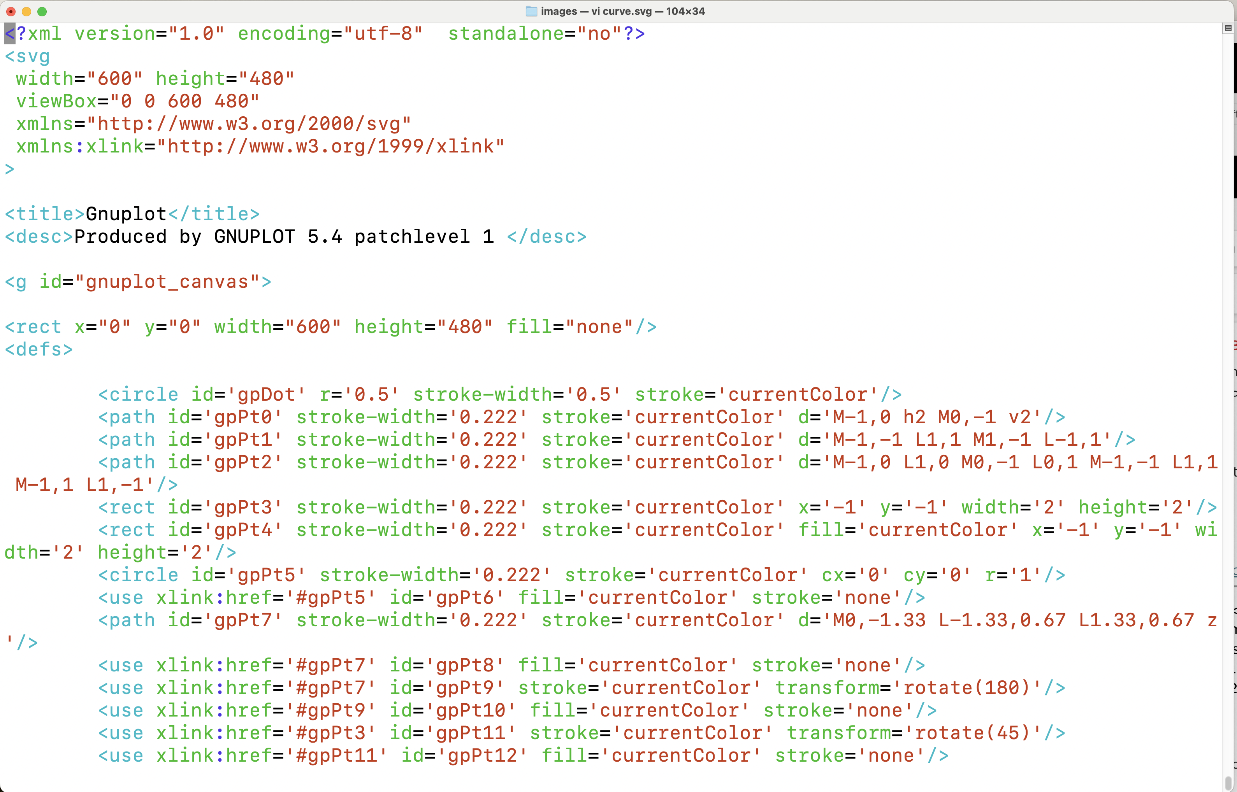
Inside of an SVG file

Slide 9
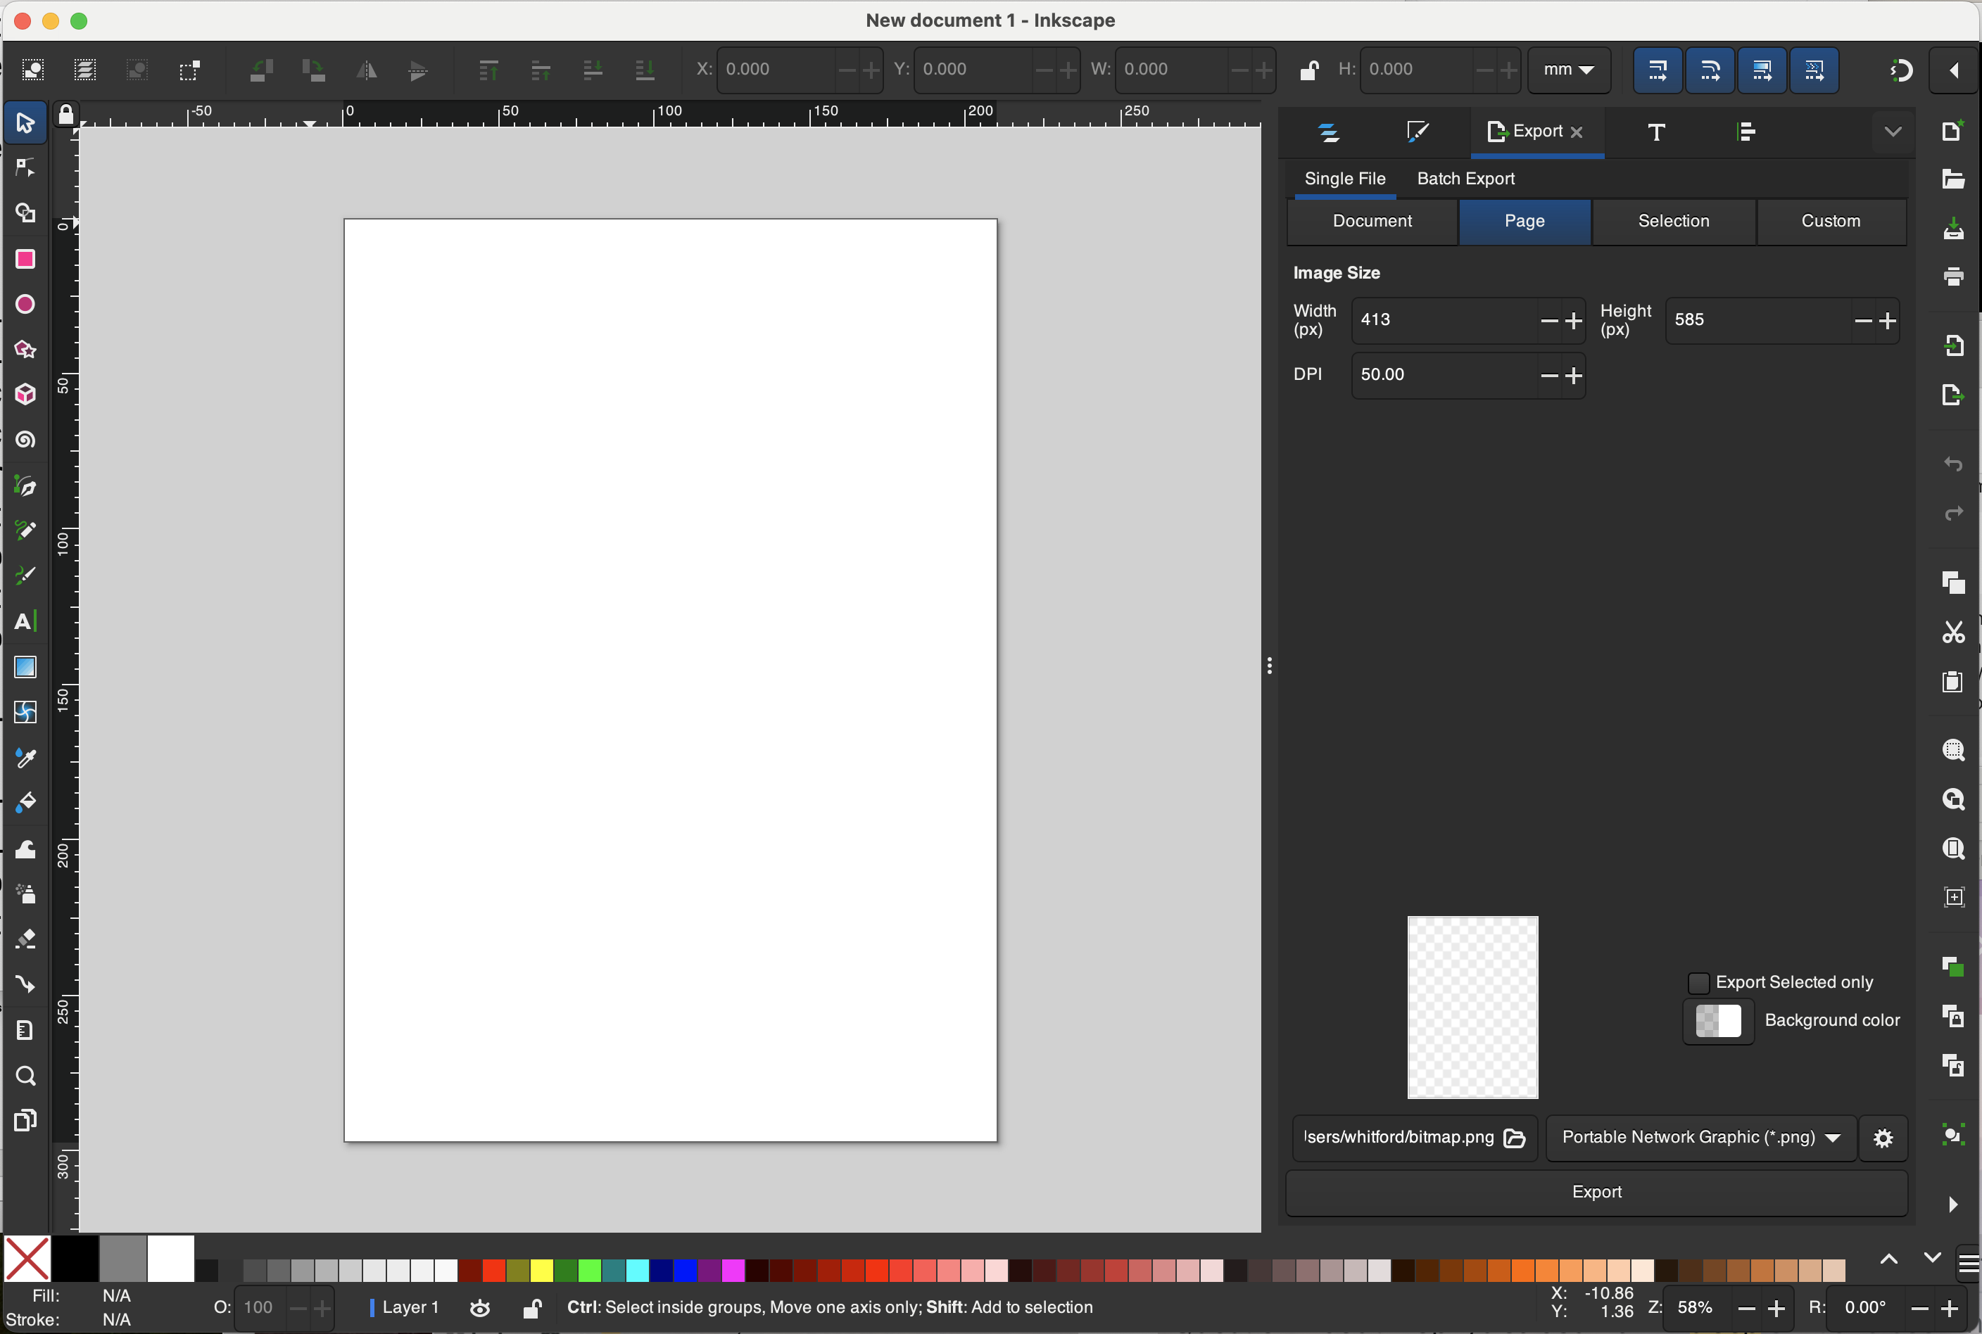
Launch Inkscape

Slide 10
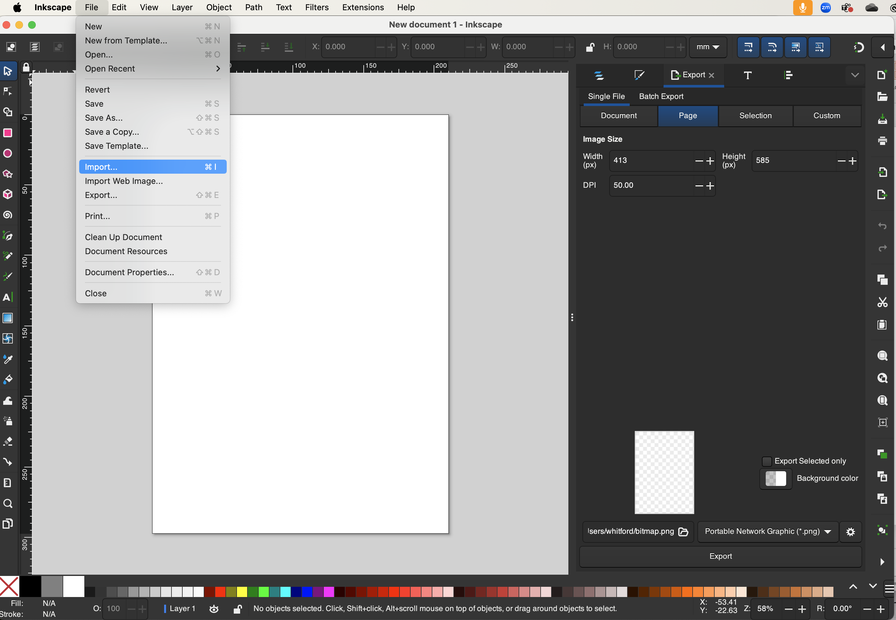
Import curve.svg

Slide 11
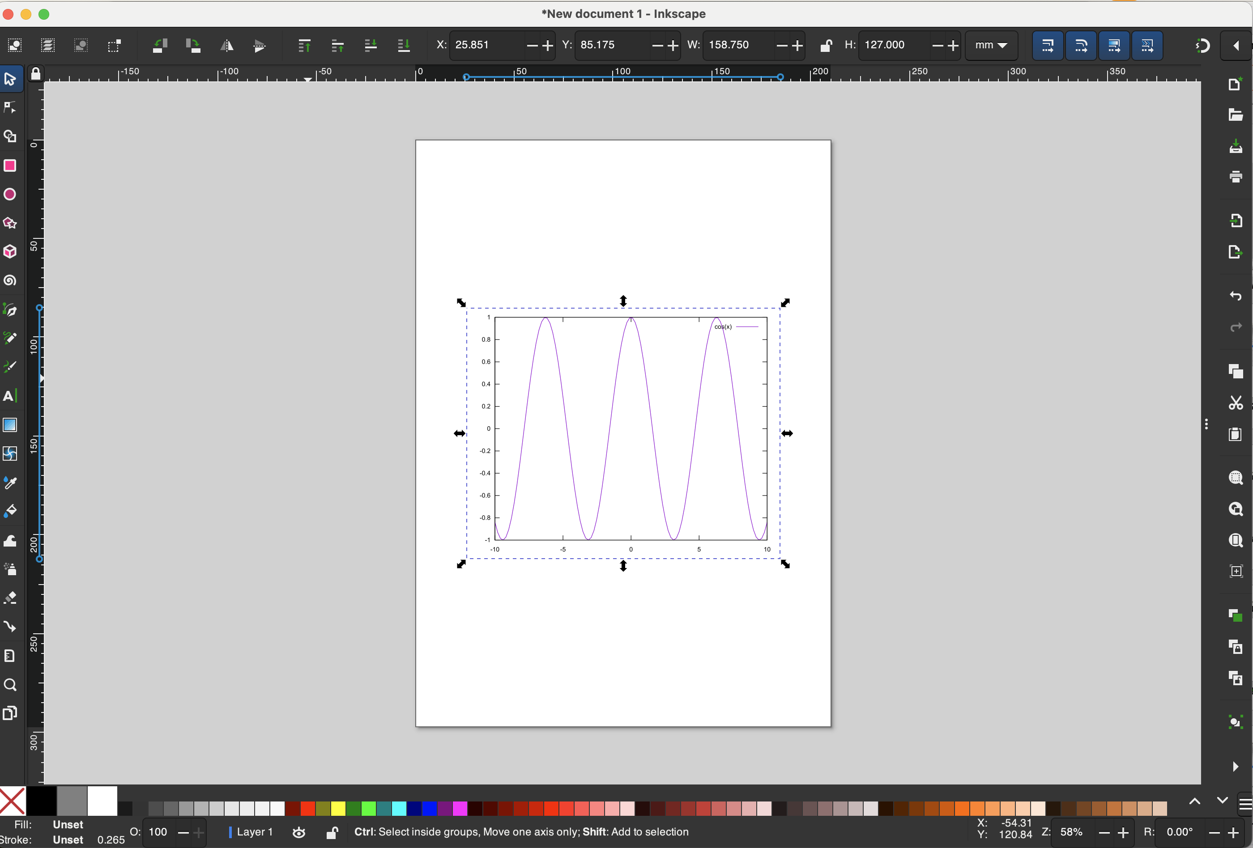

Slide 12
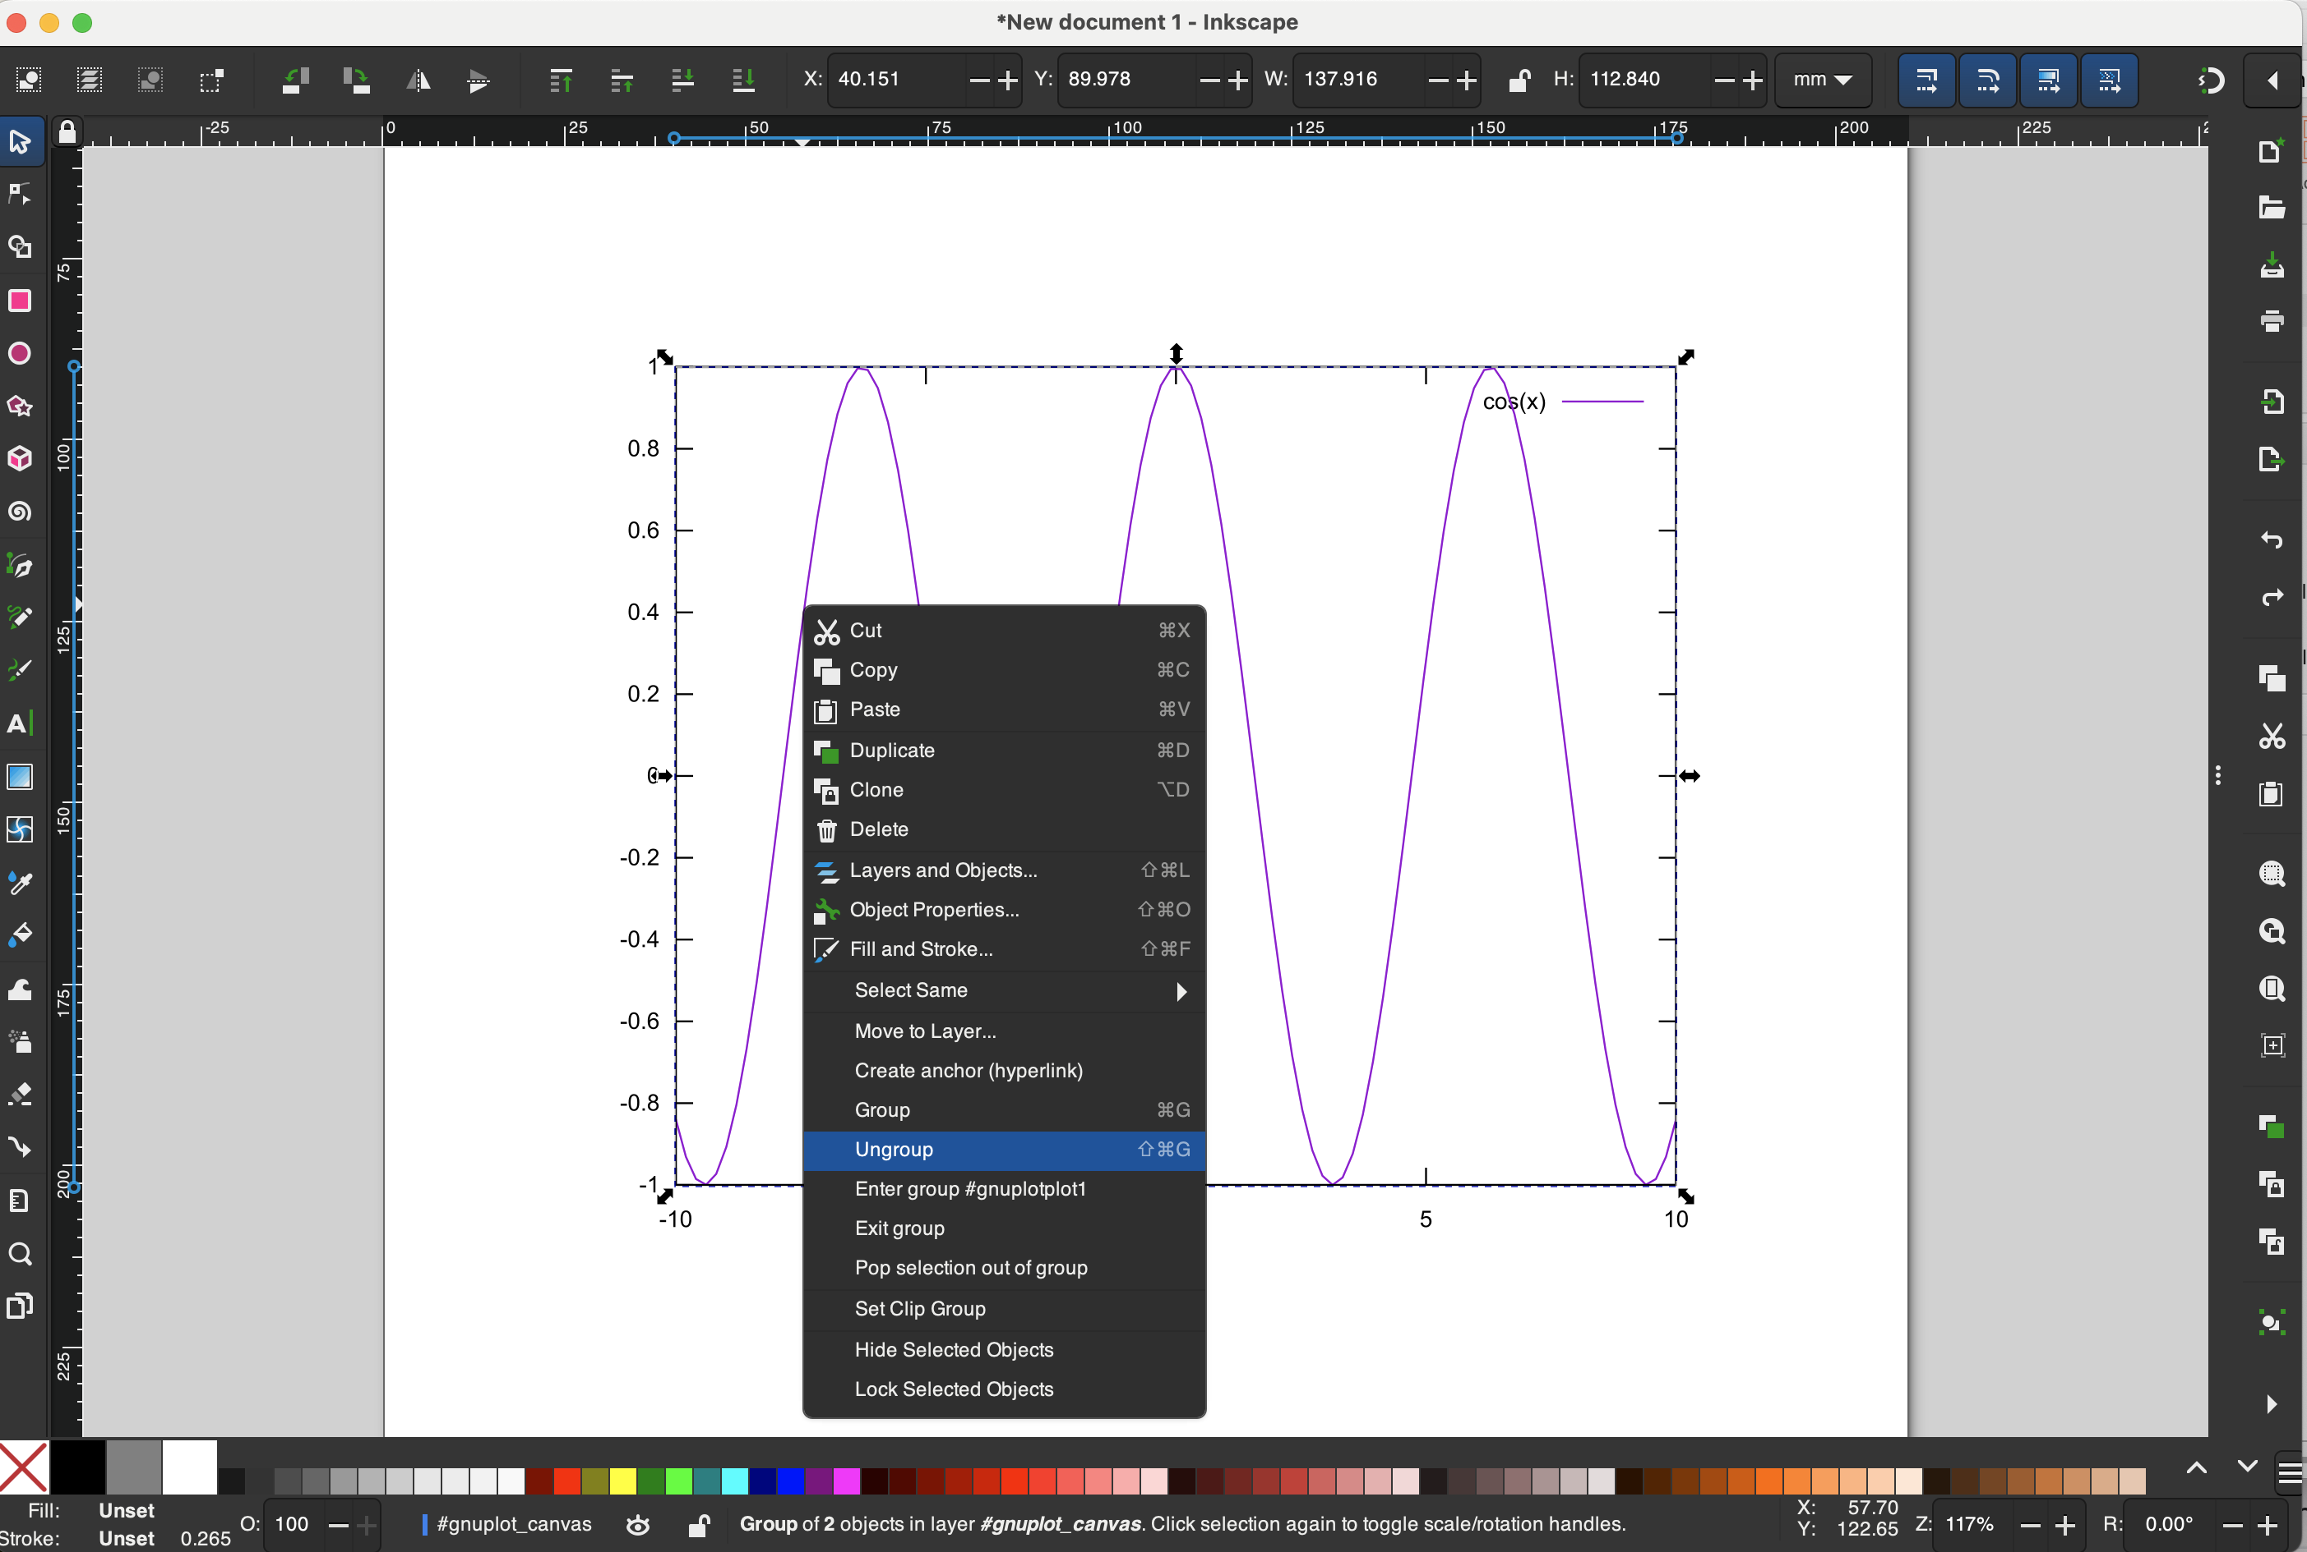
Grouping and Ungrouping
Initially, all elements may be grouped into a single editable object.
We typically want to access different elements of the object, which requires that we ungroup the vectors.
Note: Grouping may be hierarchical.
e.g. elements A and B can form a group. B may be a group of other elements

Slide 13
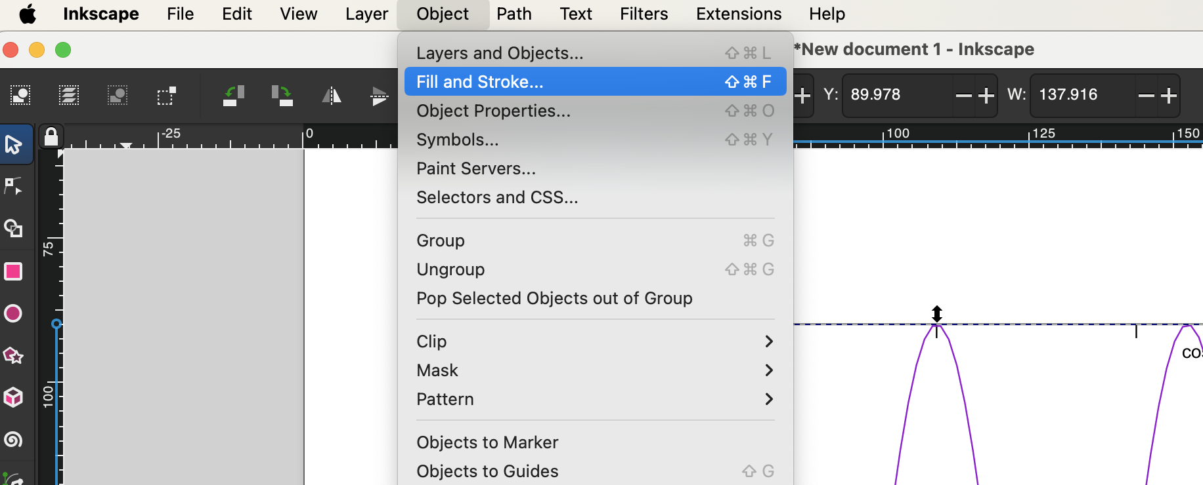
Edit the curve
Select the curve
Access the “Fill and Stroke” panel

Slide 14
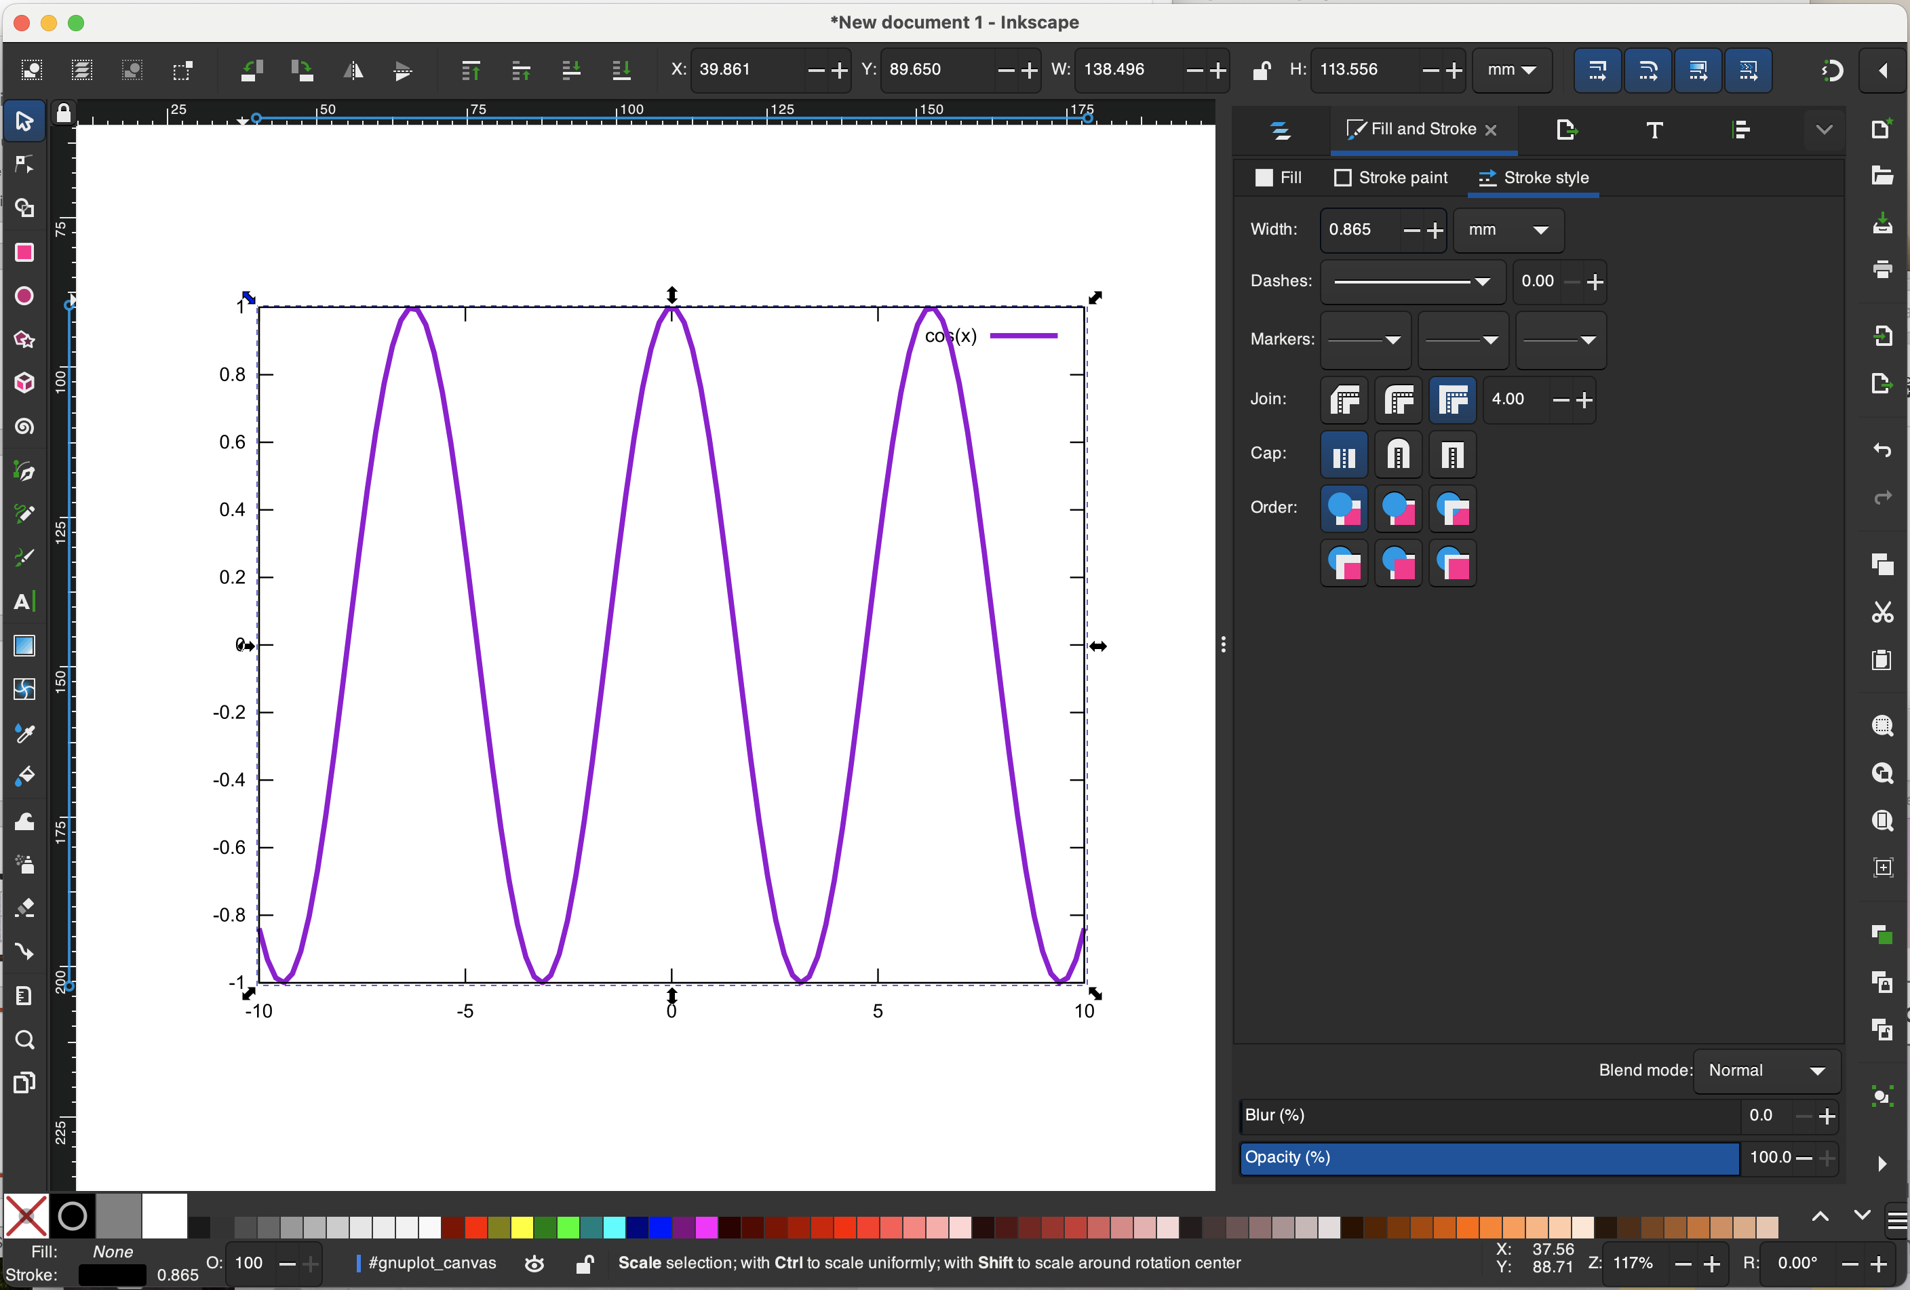
Increase line width of the curve
Can adjust each line/curve separately
Can select:
Width
style (dashed, solid)
joints (sharp, round)
caps of each line
stroke and fill color
transparency

Slide 15
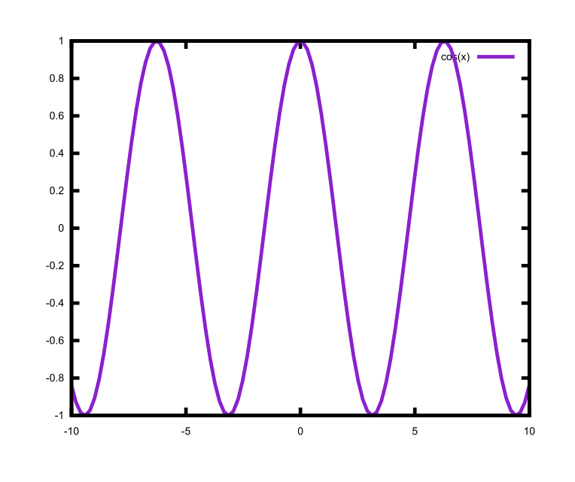
Increase width of all lines
Select the whole image
Using “Fill and Stroke” panel, choose larger width

Slide 16
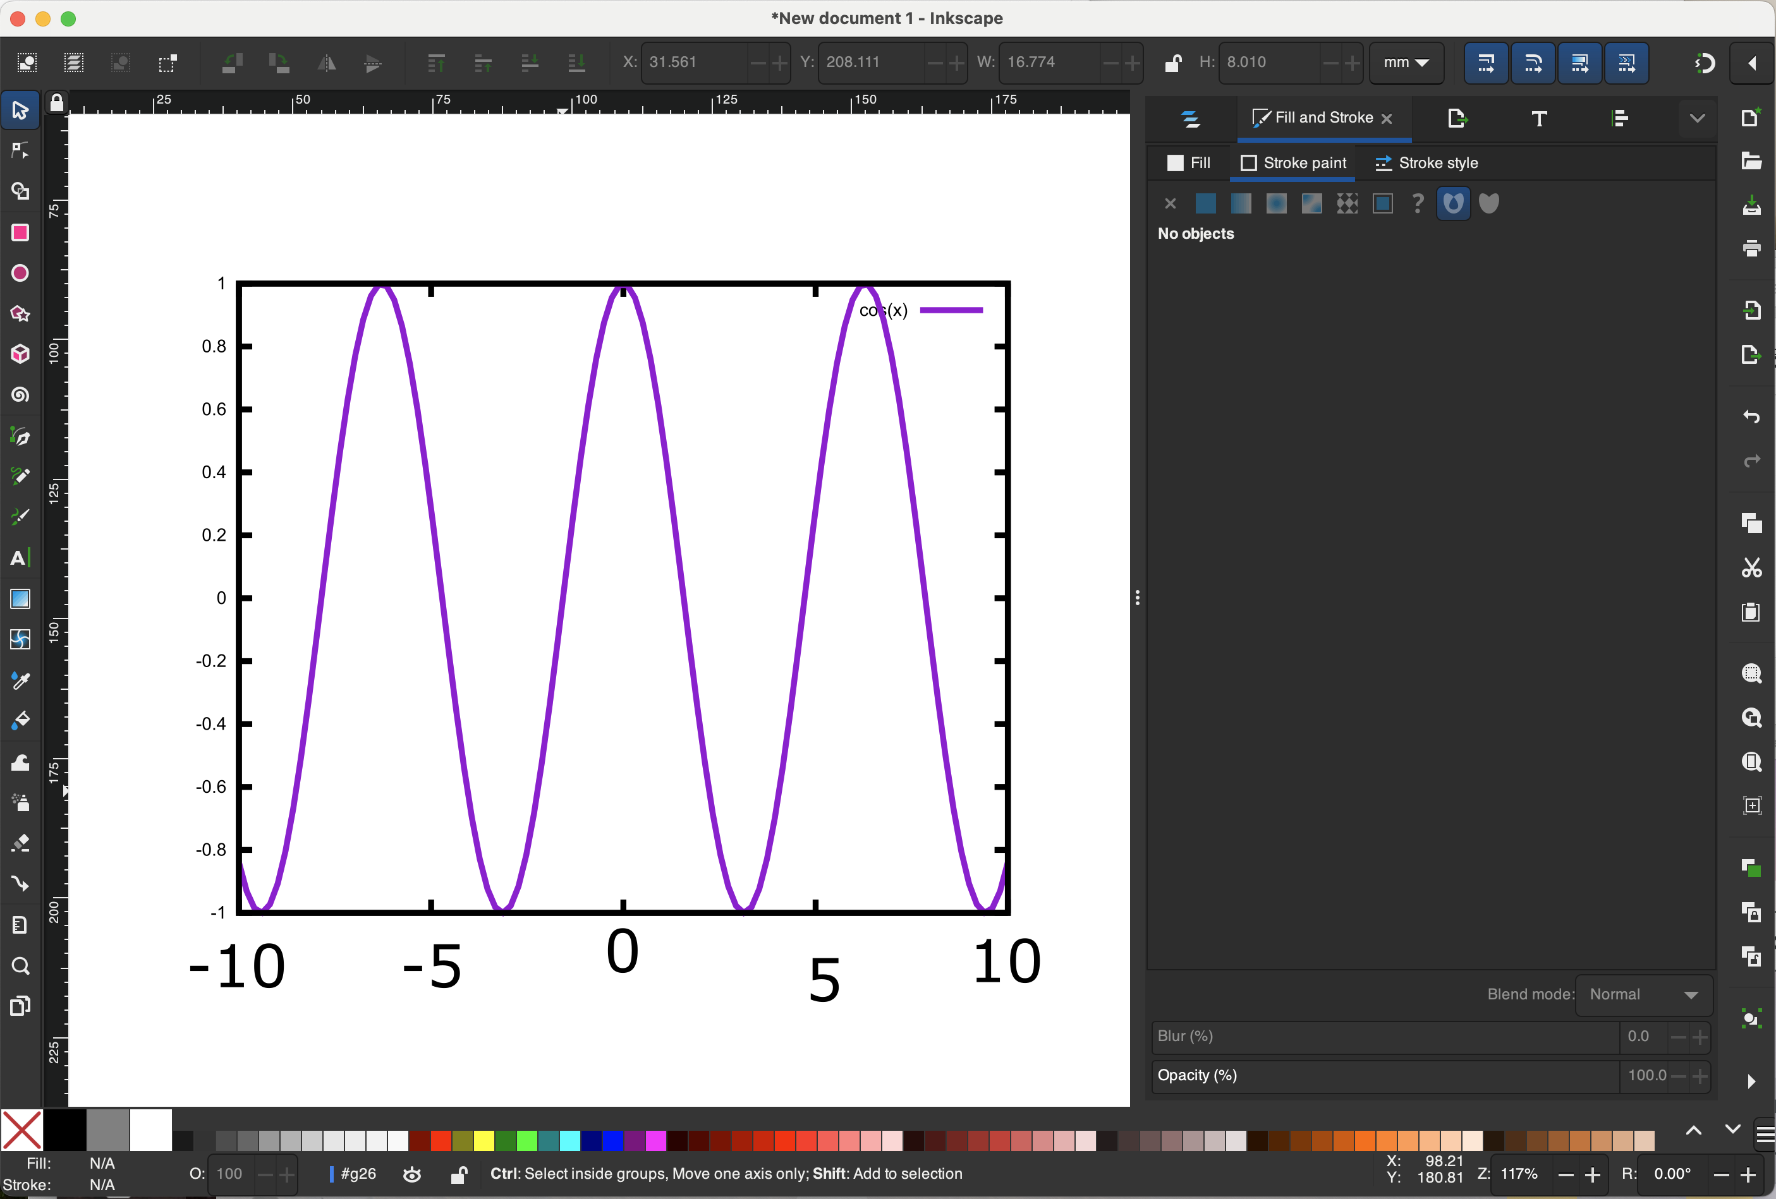
Delete and replace tick labels
Default labels often look pretty bad
Make sure to use the same font, style and size in all figures in a single manuscript
First, select and delete
Second, use “A” button to add new text boxes

Slide 17
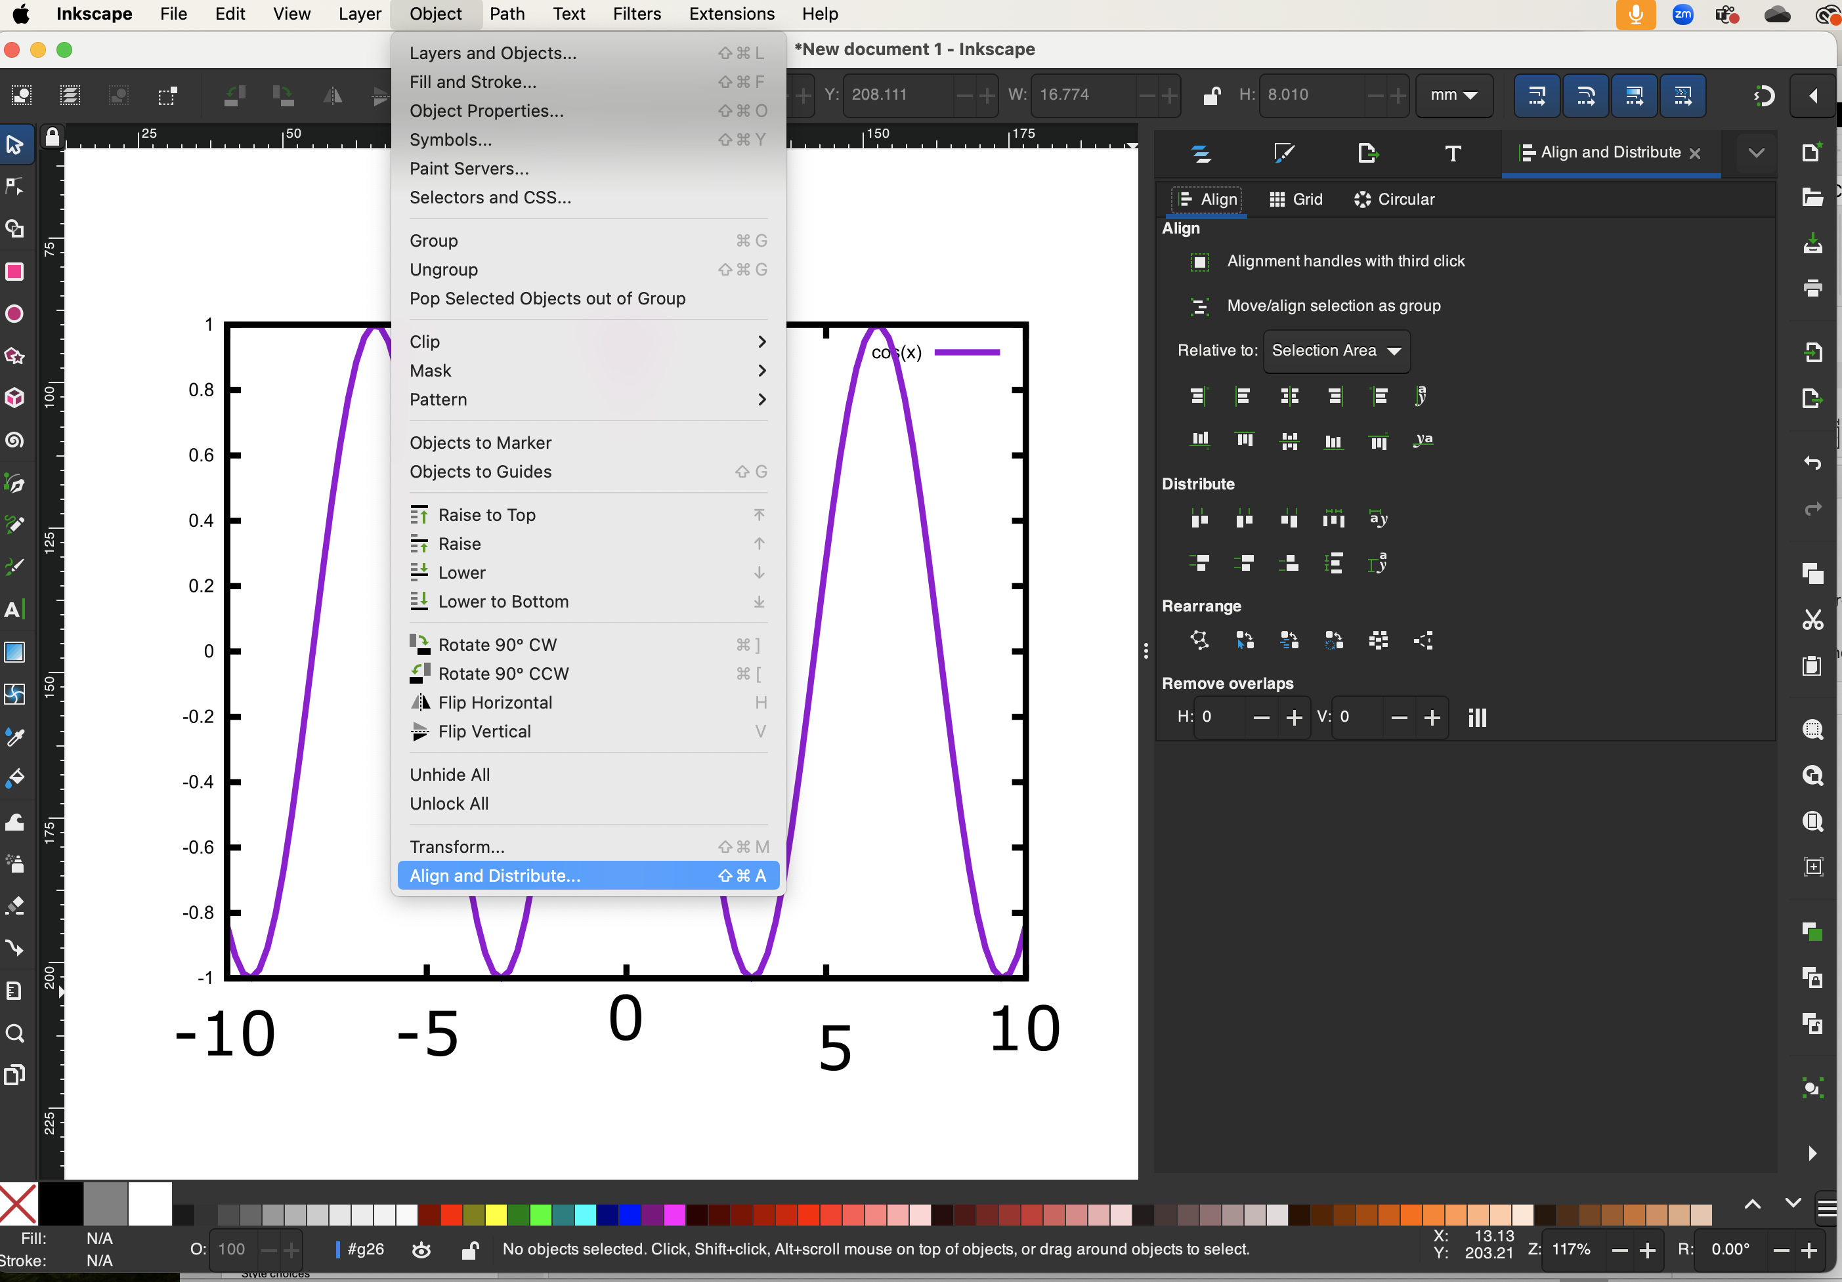
Align the labels
Open “Align and Distribute” panel
Select all elements you want to align
Align or distribute as you want
Align = place in a line, based on the top, bottom, middle, side, etc
Distribute = space the objects evenly in a direction

Slide 18
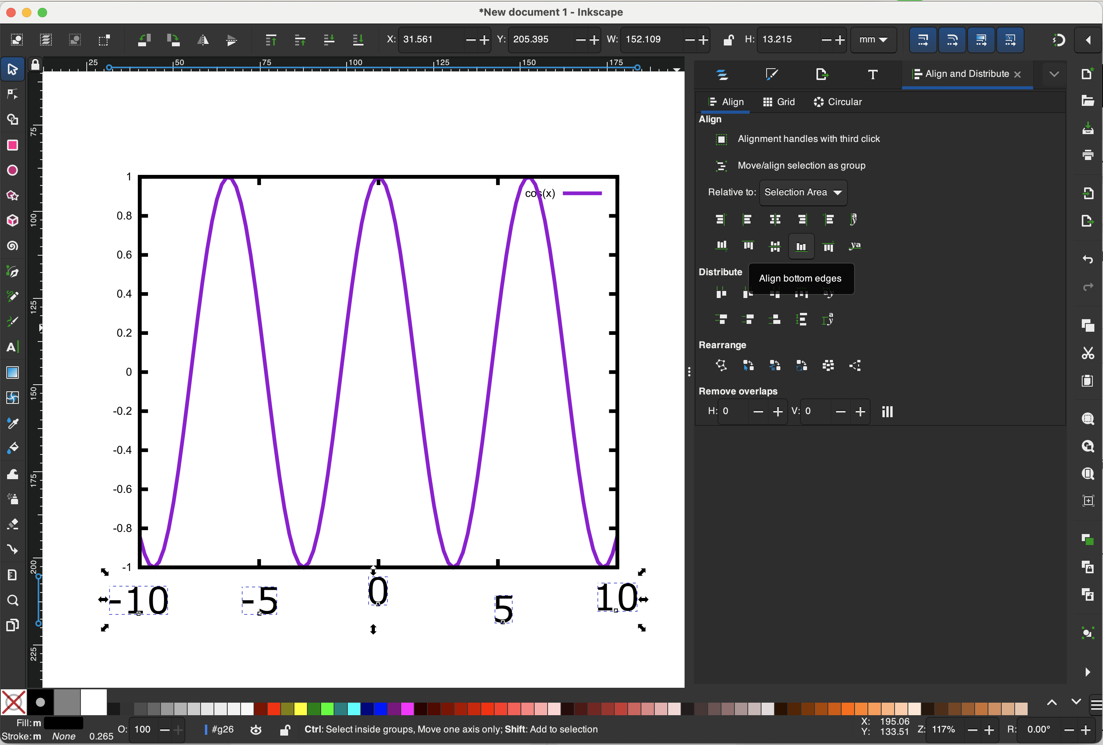

Slide 19
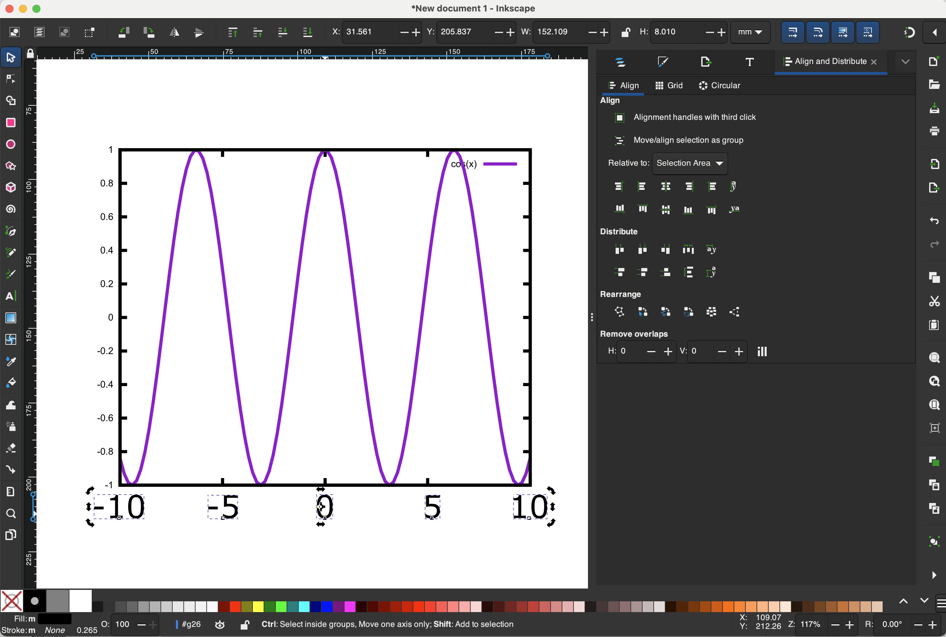

Slide 20
Layers
Think of all the objects as sitting on top of transparencies. Content on the top transparency is visible and can cover content on lower levels.
A layer is essentially a digital transparency that can be moved up/down
Let’s move an object/group to the top layer

Slide 21
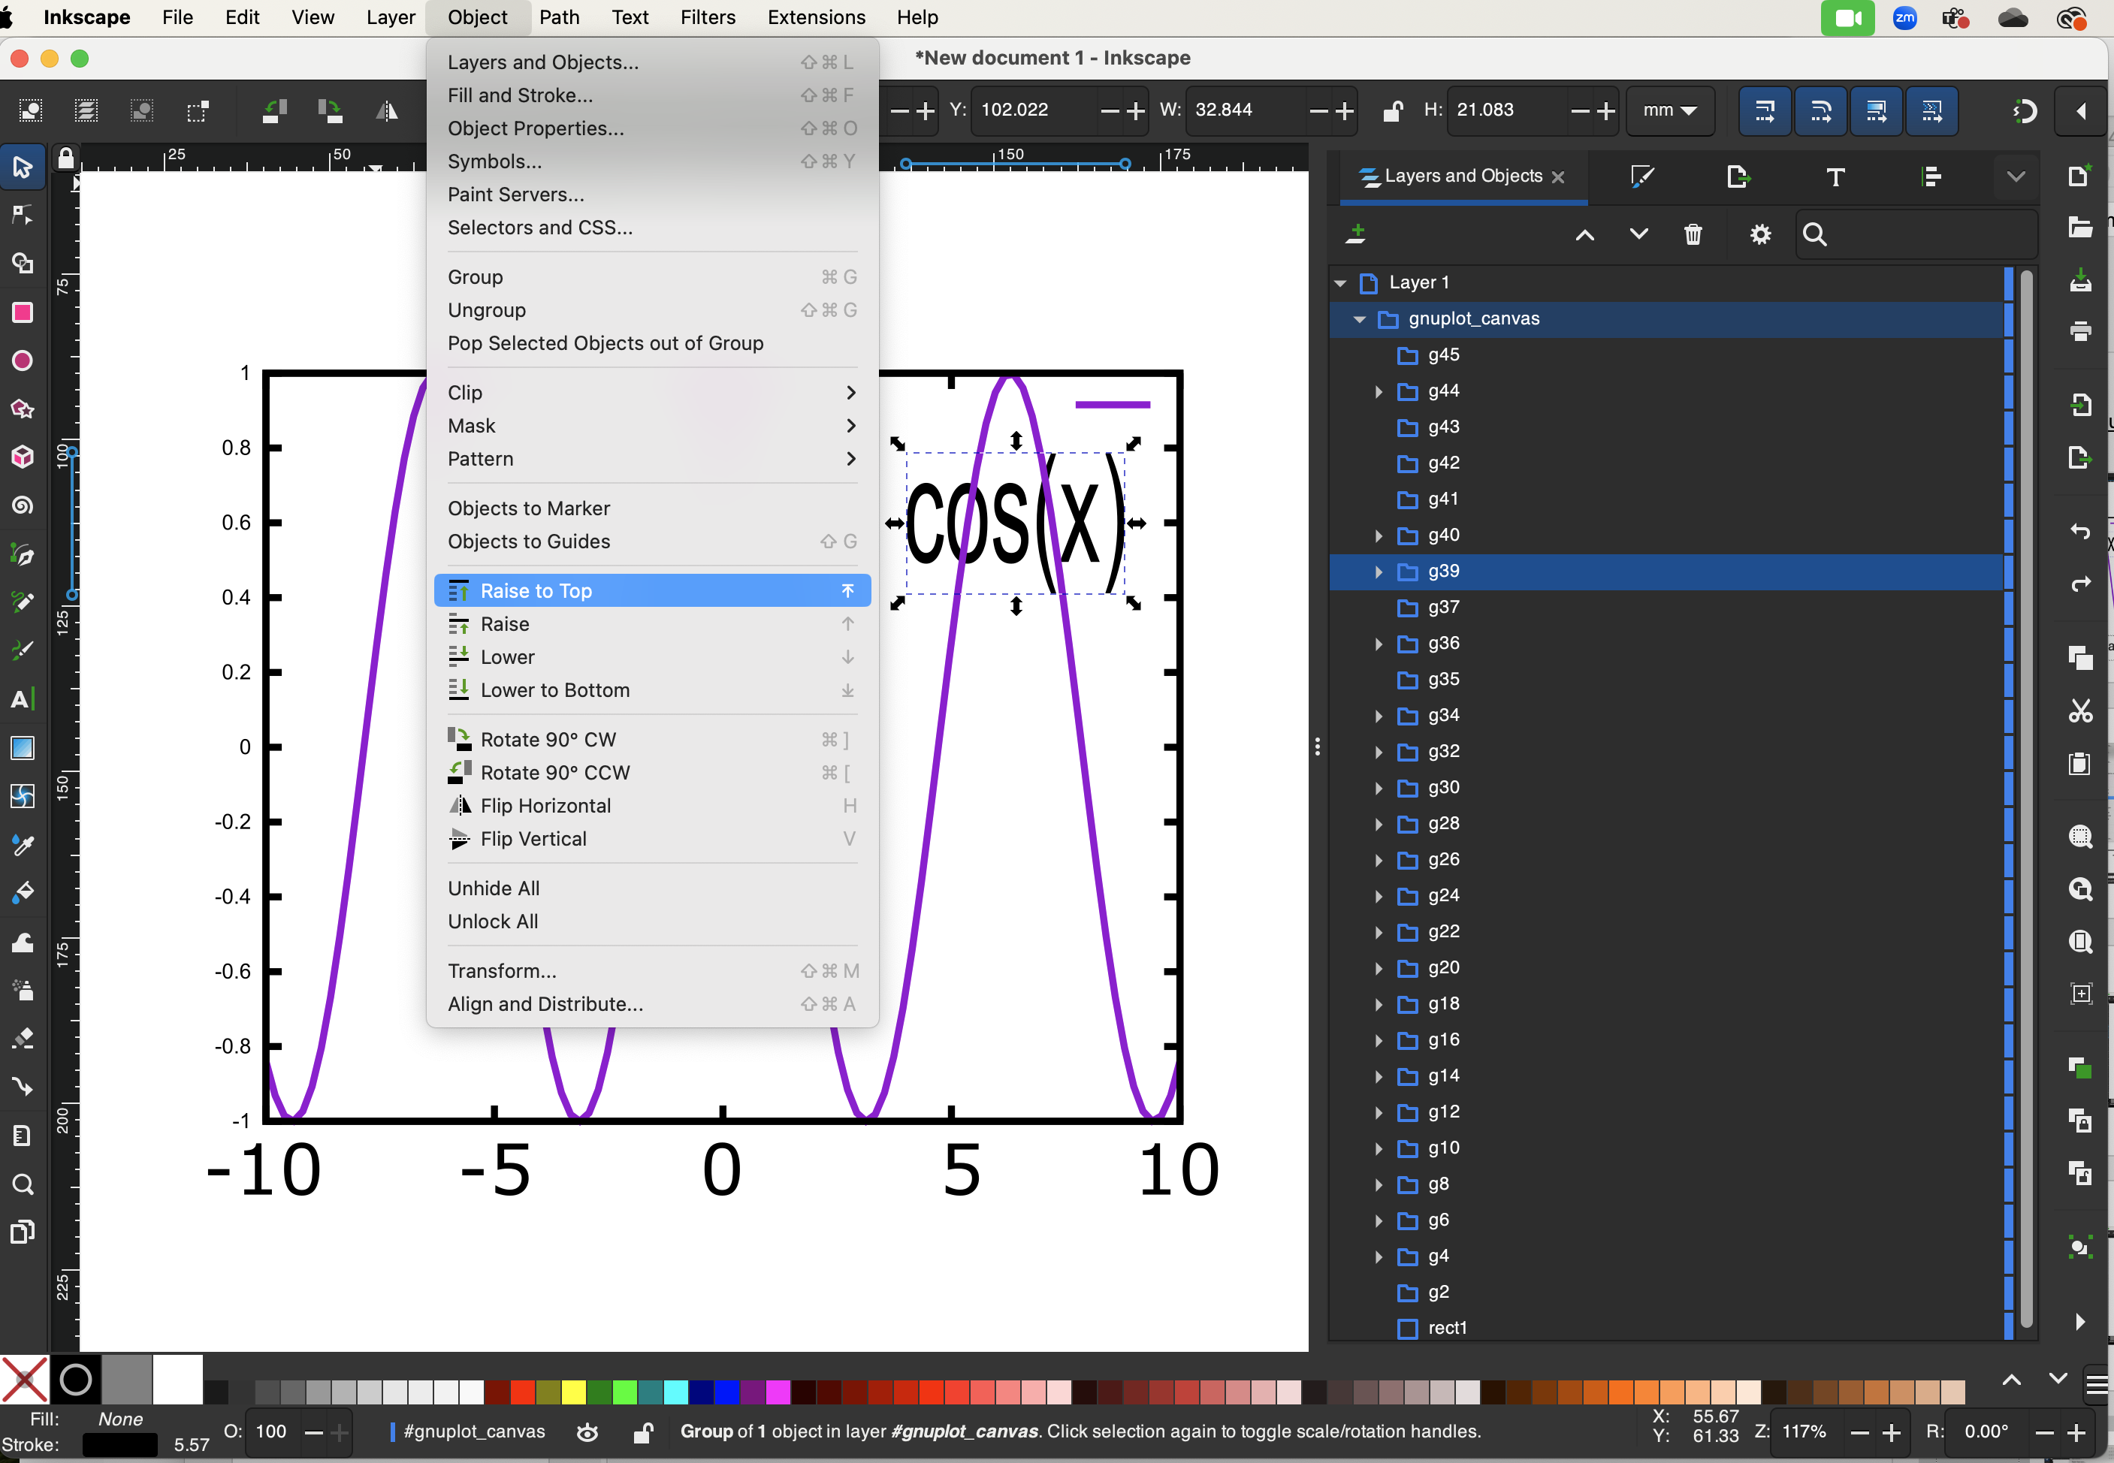
Select the “cos(x)” and make it larger
Occluded by the curve
Let’s raise it above the curve

Slide 22
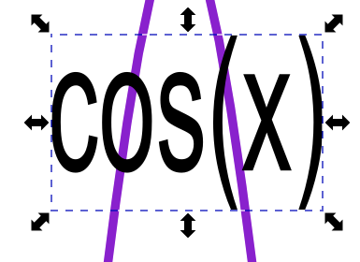
before
after

Slide 23
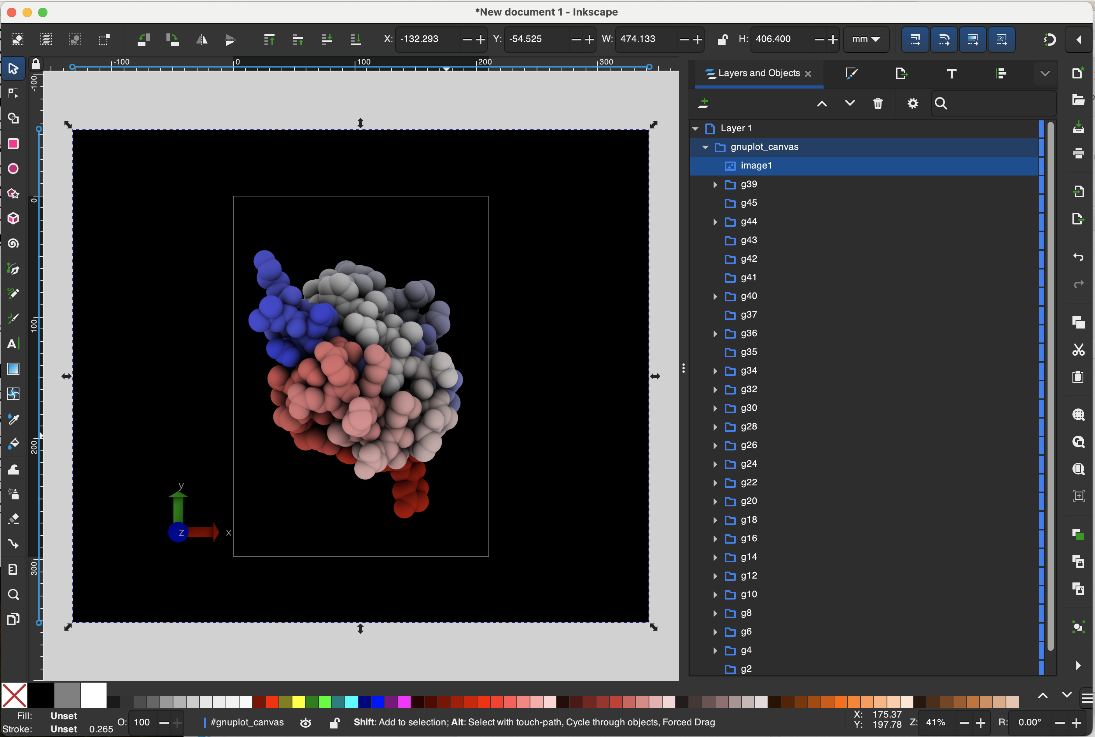
Import “black.tga”

Slide 24
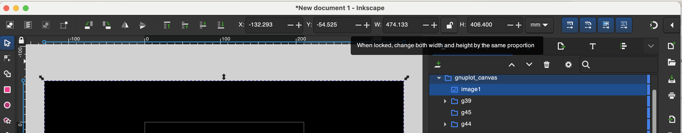
Lock the aspect ratio

Slide 25
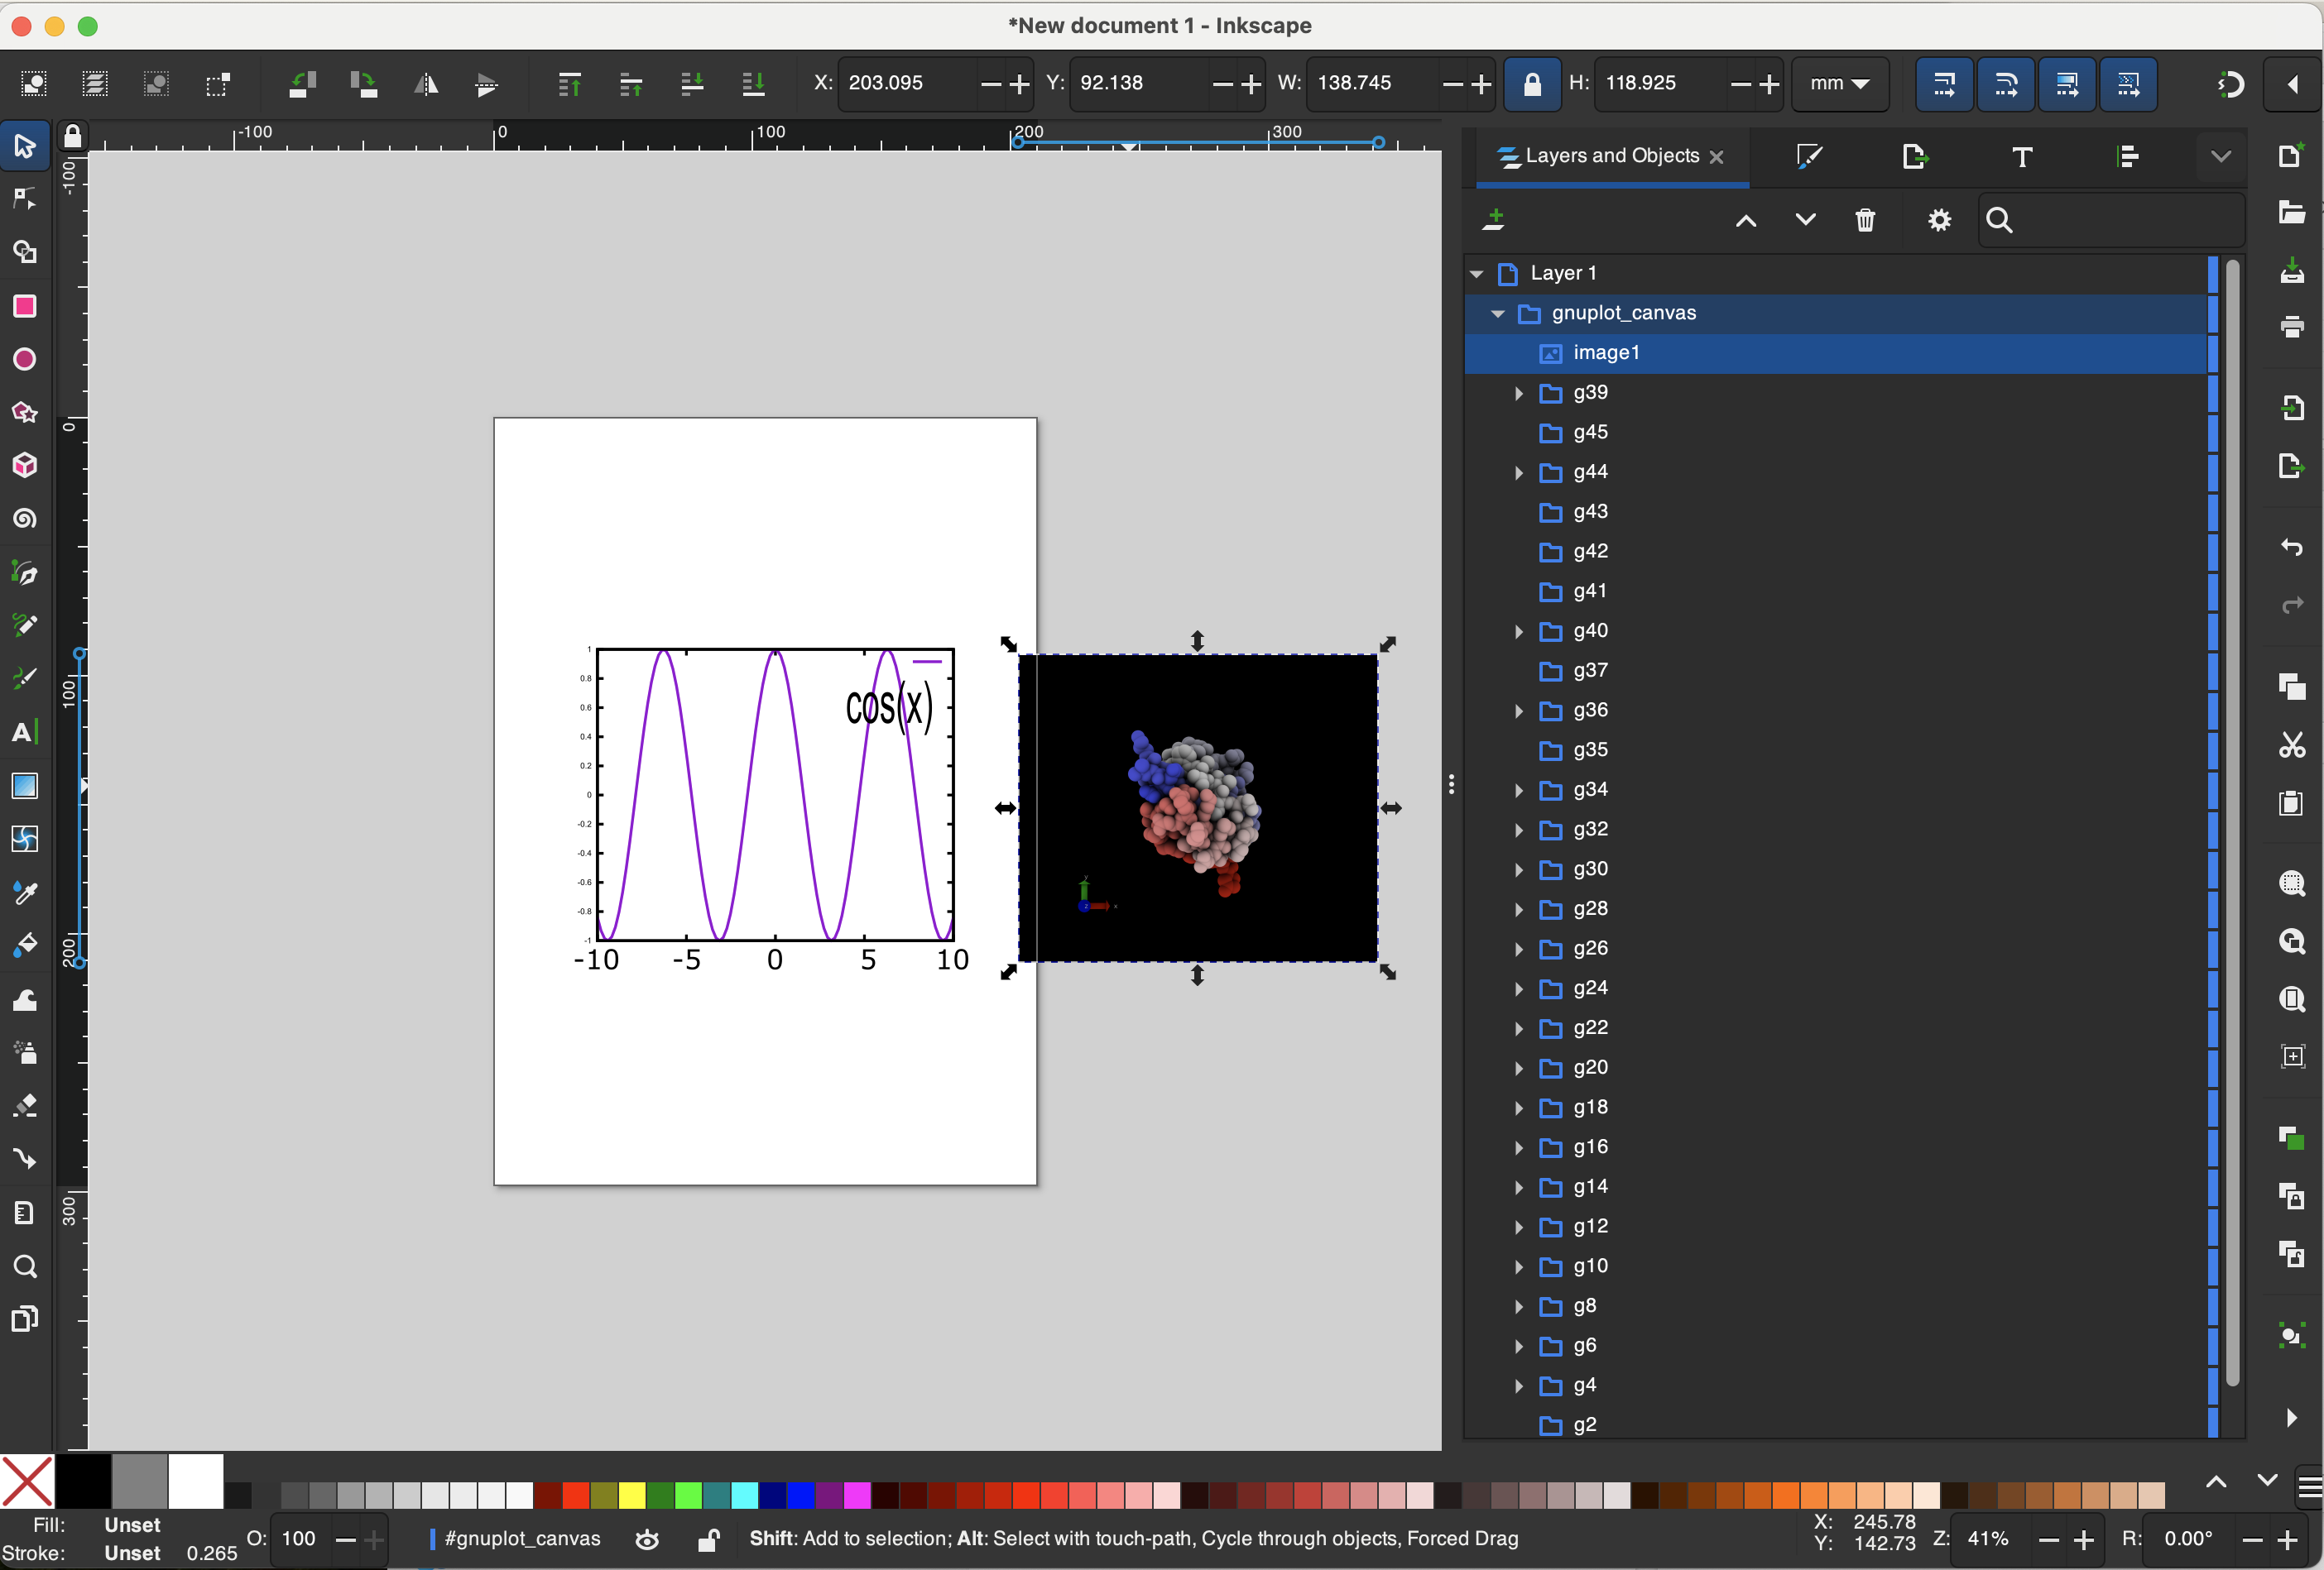
Resize and reposition

Slide 26
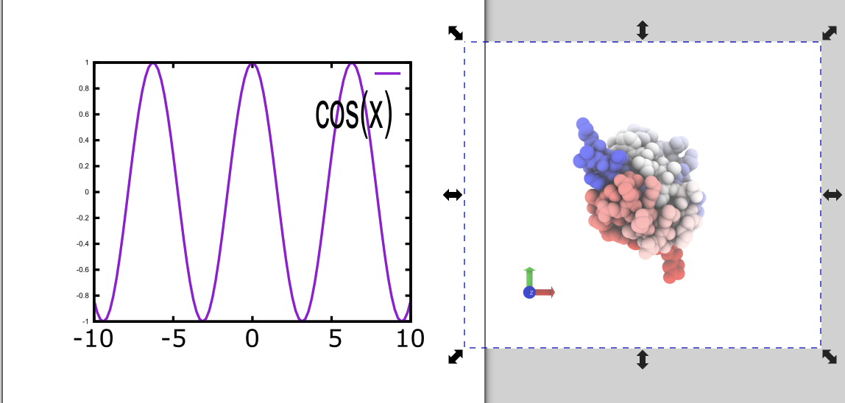
Delete and import “white.tga”

Slide 27
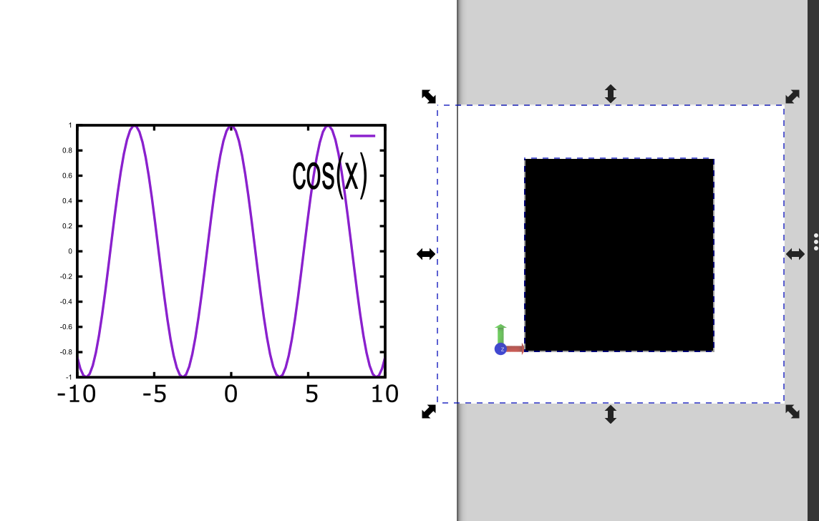
crop
If you want to crop and image, then draw a shape over it. In this case, a black rectangle

Slide 28
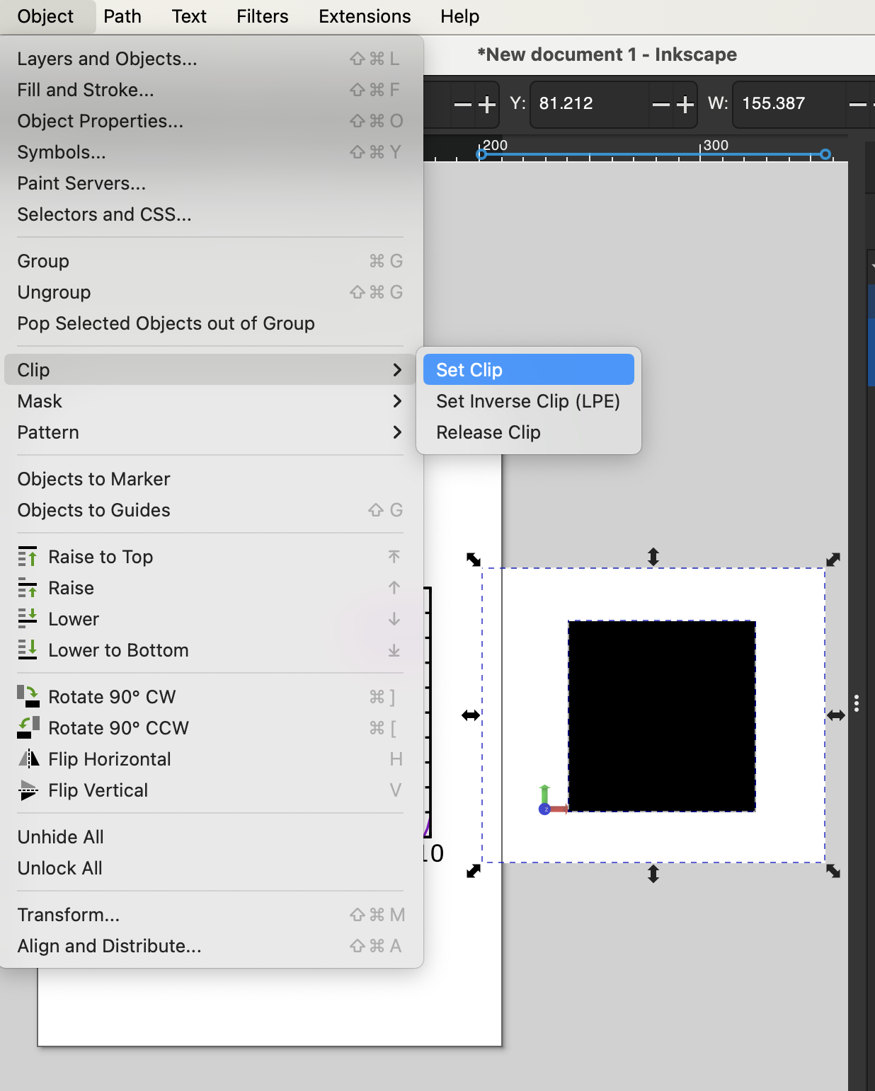
crop
With both the bottom image and the rectangle selected, click
Object->Clip->Set Clip

Slide 29
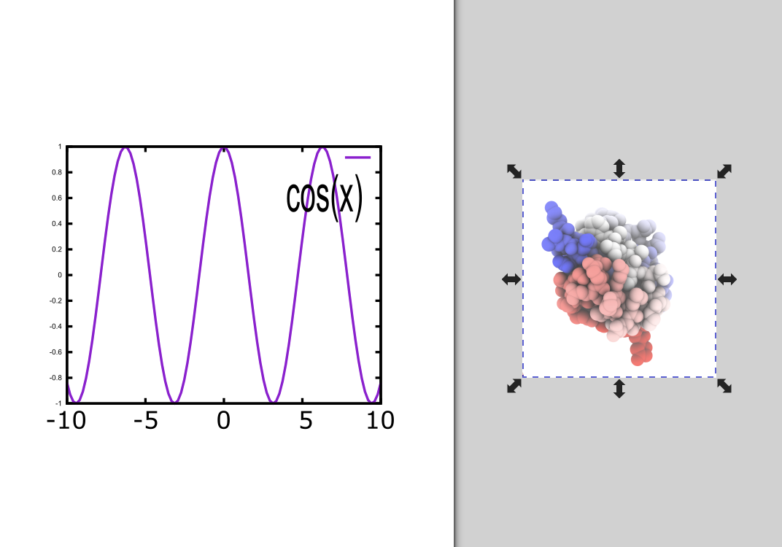

Slide 30
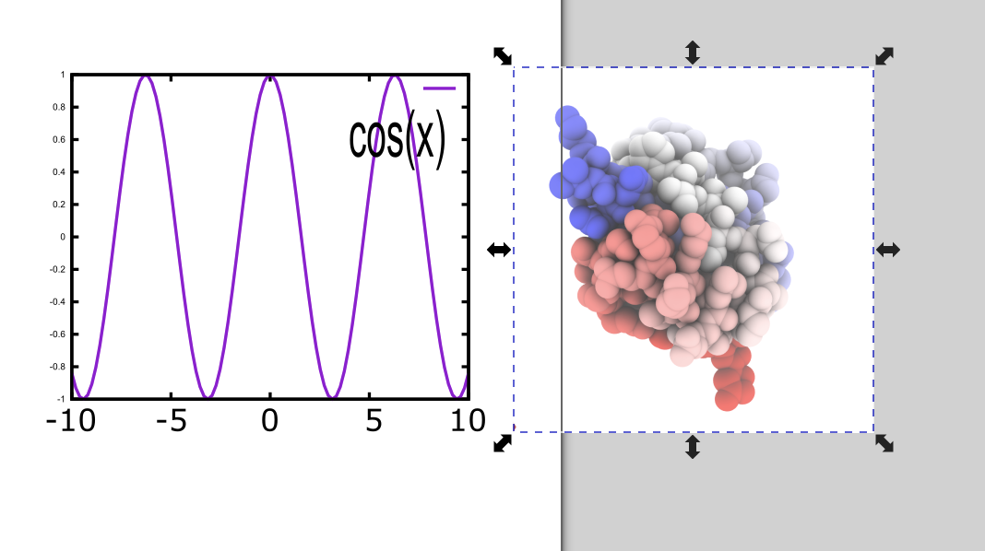
Reposition and resize

Slide 31
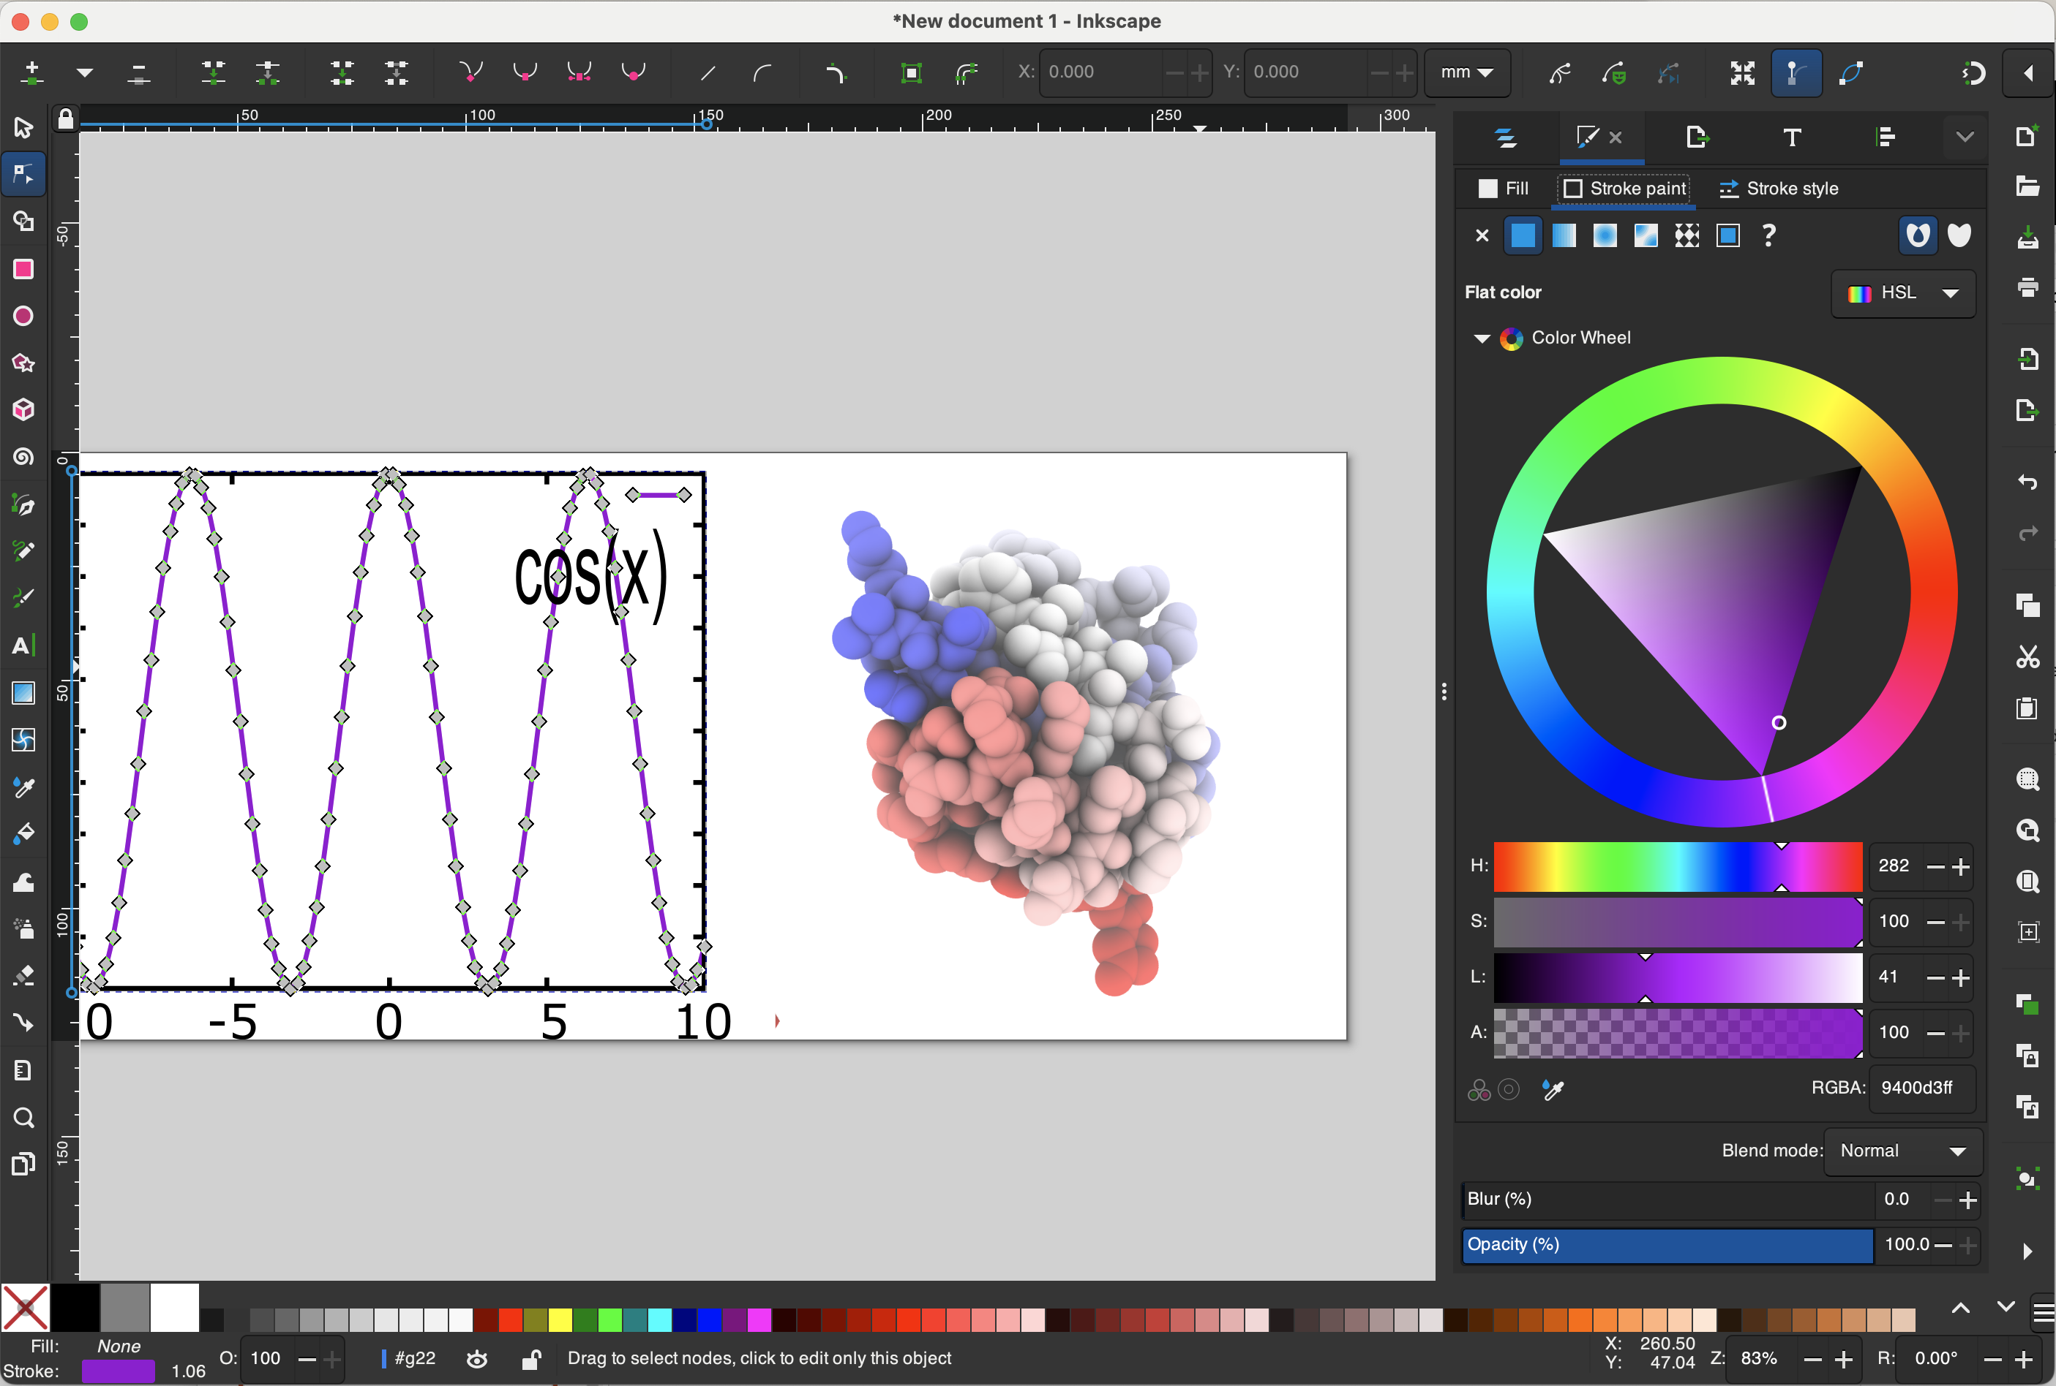
Color options
Select the curve
This may require going into multiple layers of the graph object
Go to “Stroke and Fill” panel
Select “Stroke paint” tab

Slide 32
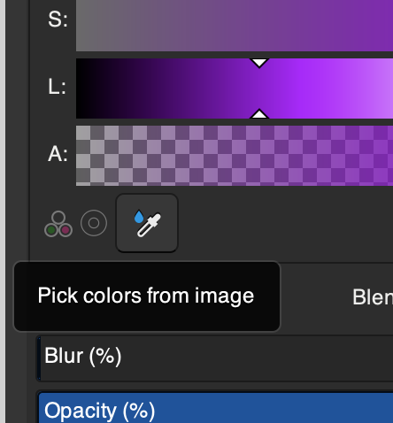
We want to set the curve to be exactly the same color as part of our molecule
With the curve selected, click the eye drop symbol
Click something and the curve will become that color

Slide 33
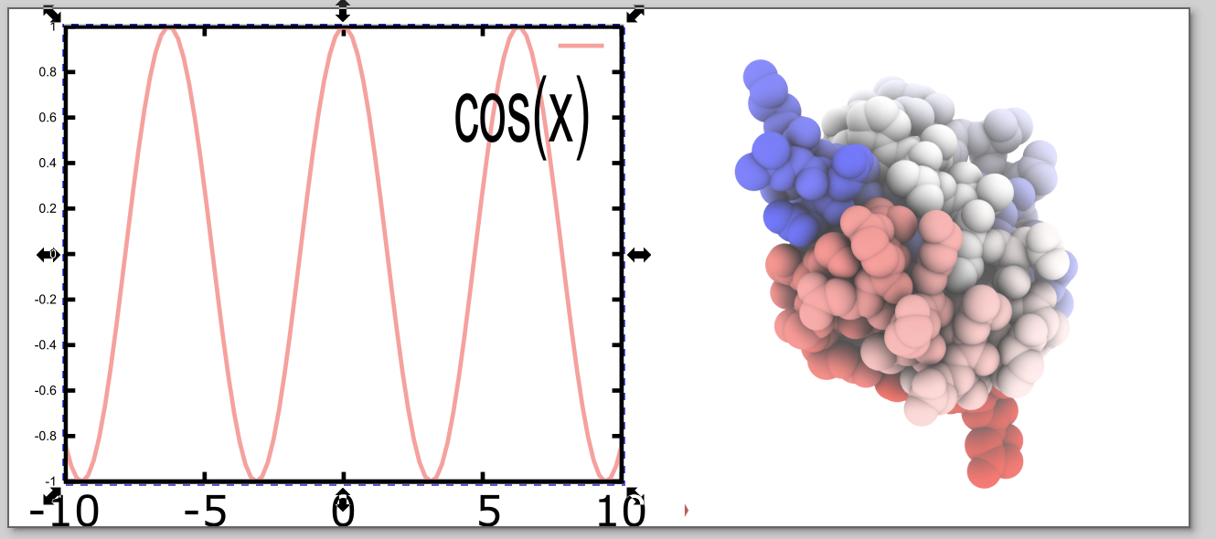
This ability to choose colors is particularly useful when adding labels to a complex molecular system.

Slide 34
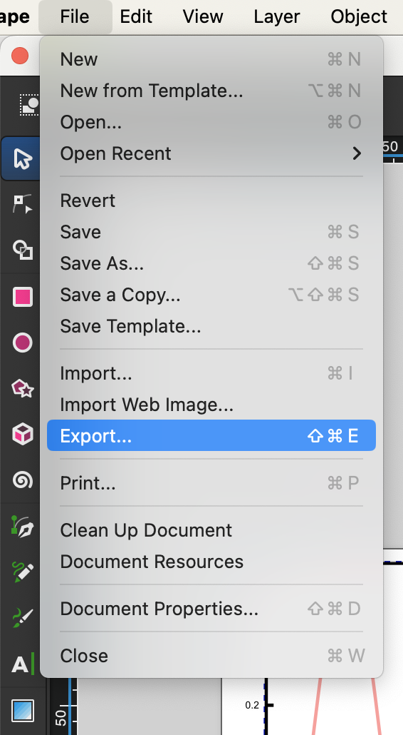
Create a bitmap to be submitted

Slide 35
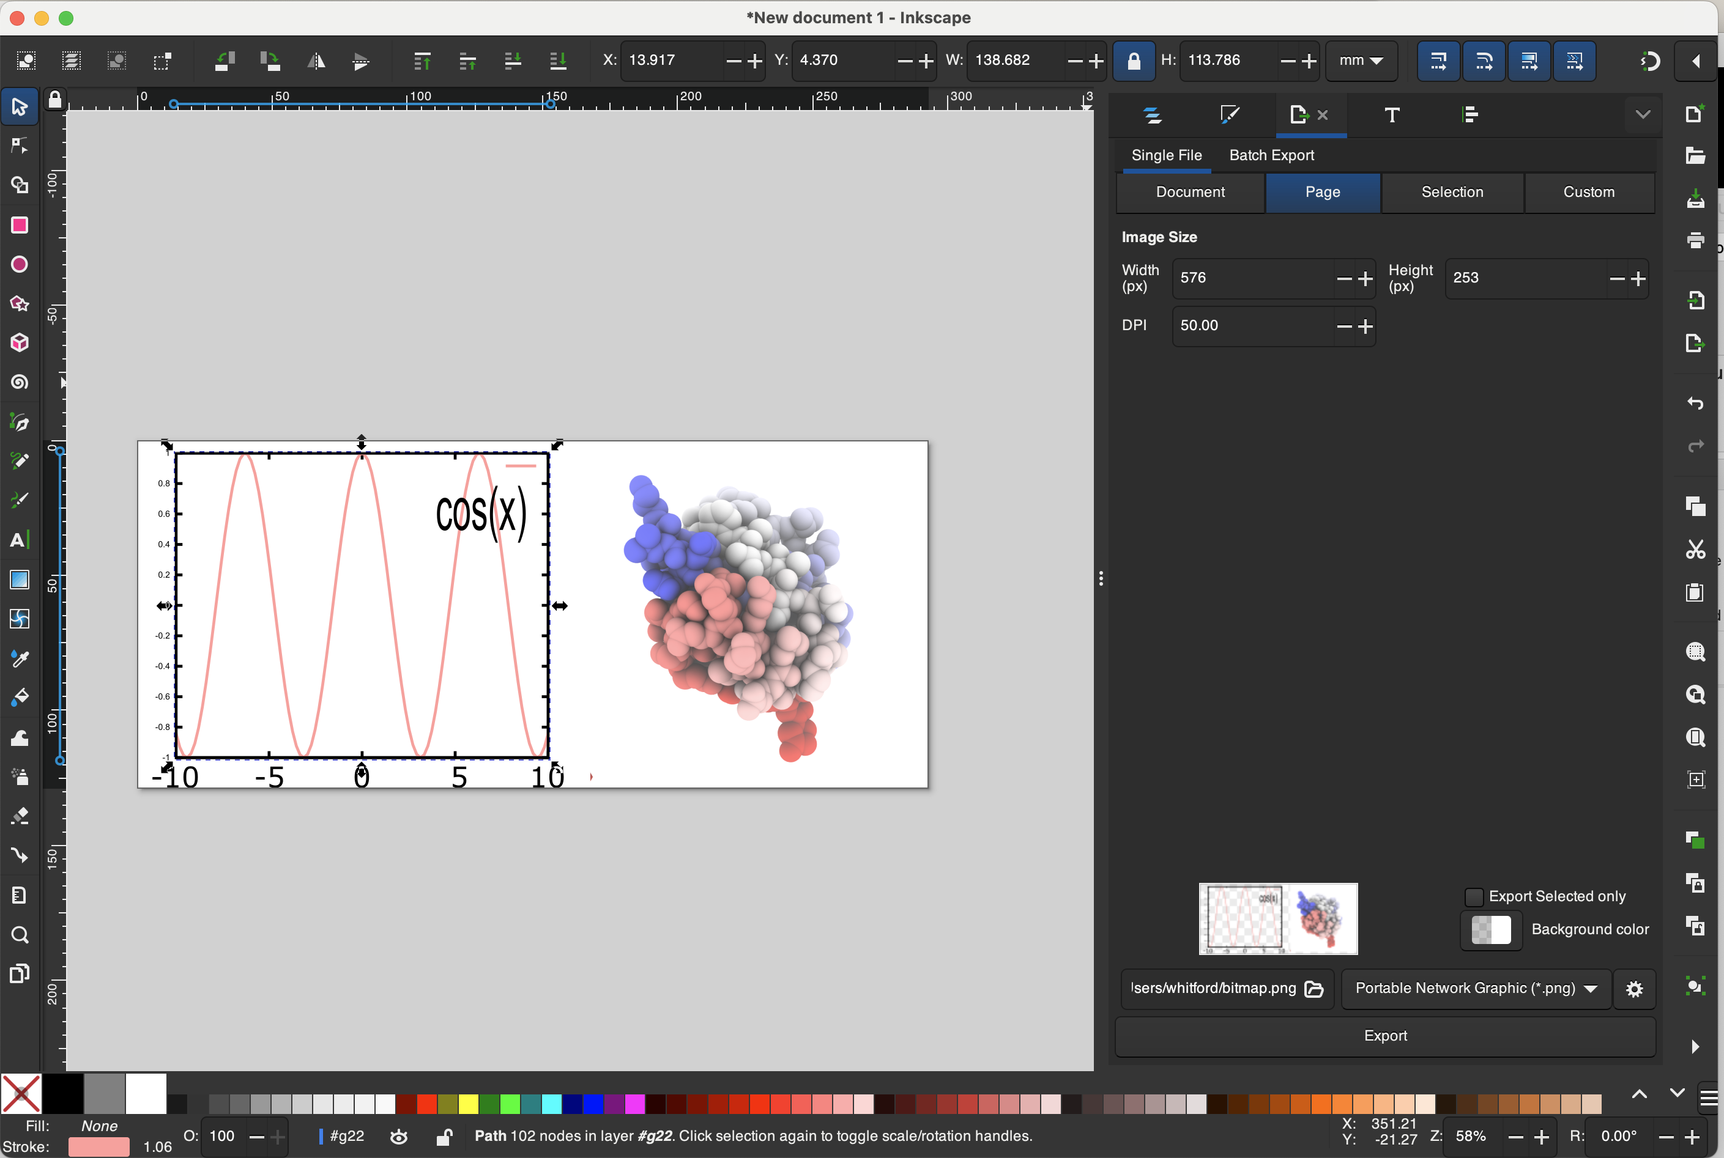
In the export panel, indicate the type of bitmap you want to export, the resolution/size, file name, etc.
Hit “Export”

Slide 36
Good luck!
Be creative.
If you can think of something you want to do, someone probably has a Youtube video showing exactly how to do it.

